Slide 1










Slide 2
School Segregation in New Jersey
A pandemic of inequality & lost opportunity
Friday, September 24 • 10:00 am to 3:00 pm
The Conference Center at Mercer

Slide 3





















Slide 4


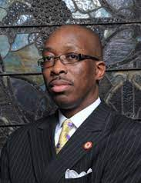
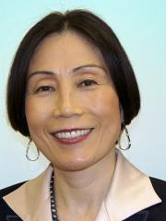
Opening Session
Conference Co-Chairs:
Rev. Kenneth Darryl Ray Clayton & Rev. Willie Dwayne Francois III
Call to Order - Rev. Clayton
Welcome/Purpose/Overview/Rules of the Day - Rev. Clayton & Rev. Francois
Spiritual Reflection & Opening Prayer - Rev. Karen Hernandez-Granzen, Pastor, Westminster Presbyterian Church, Trenton
Welcome to MCCC - Dr. Jianping Wang, President, Mercer County Community College

Slide 5

PART I
The State of School Segregation in NJ in the age of Covid-19
Myron Orfield
Professor of Civil Rights & Civil Liberties Law,
Director of the Institute on Metropolitan Opportunity at the University of Minnesota Law School
New Data on racial & economic segregation by school district in NJ.
Deepening economic & racial isolation of intensely segregated urban schools.
Growing diversity yet resegregation in many suburbs – the problem & the political opportunity.
Poverty for some; Profit for others - the monetization of segregation & the poverty industrial complex
What & Who we are up against.

Slide 6
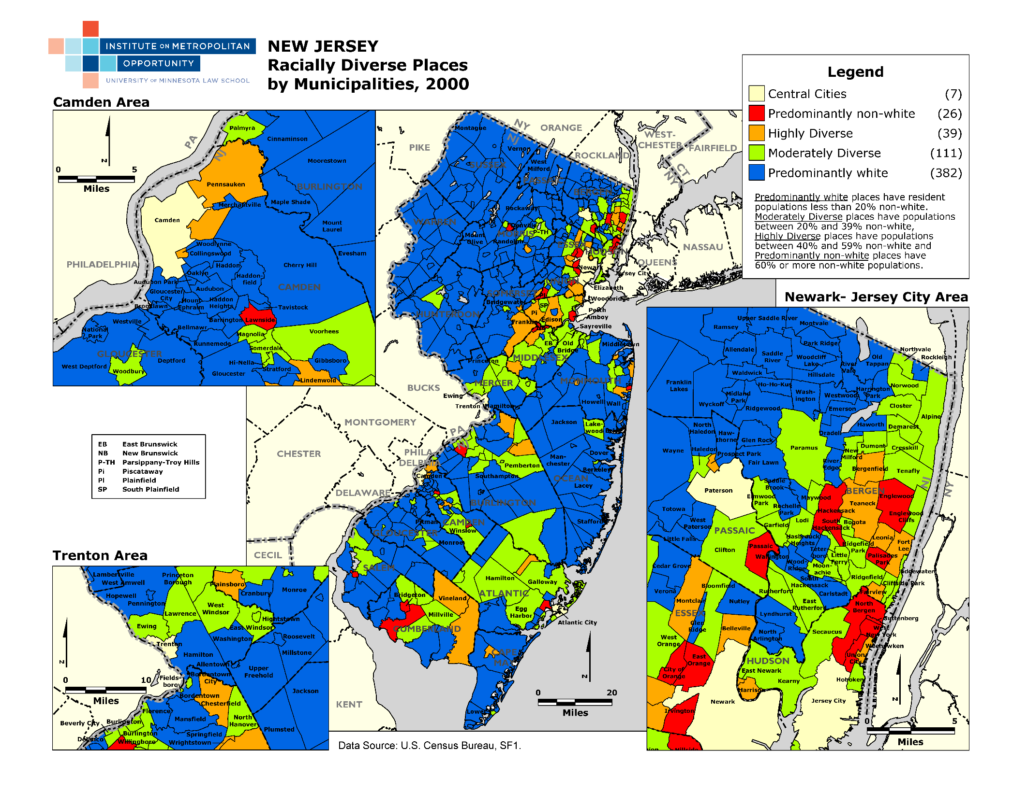

Slide 7
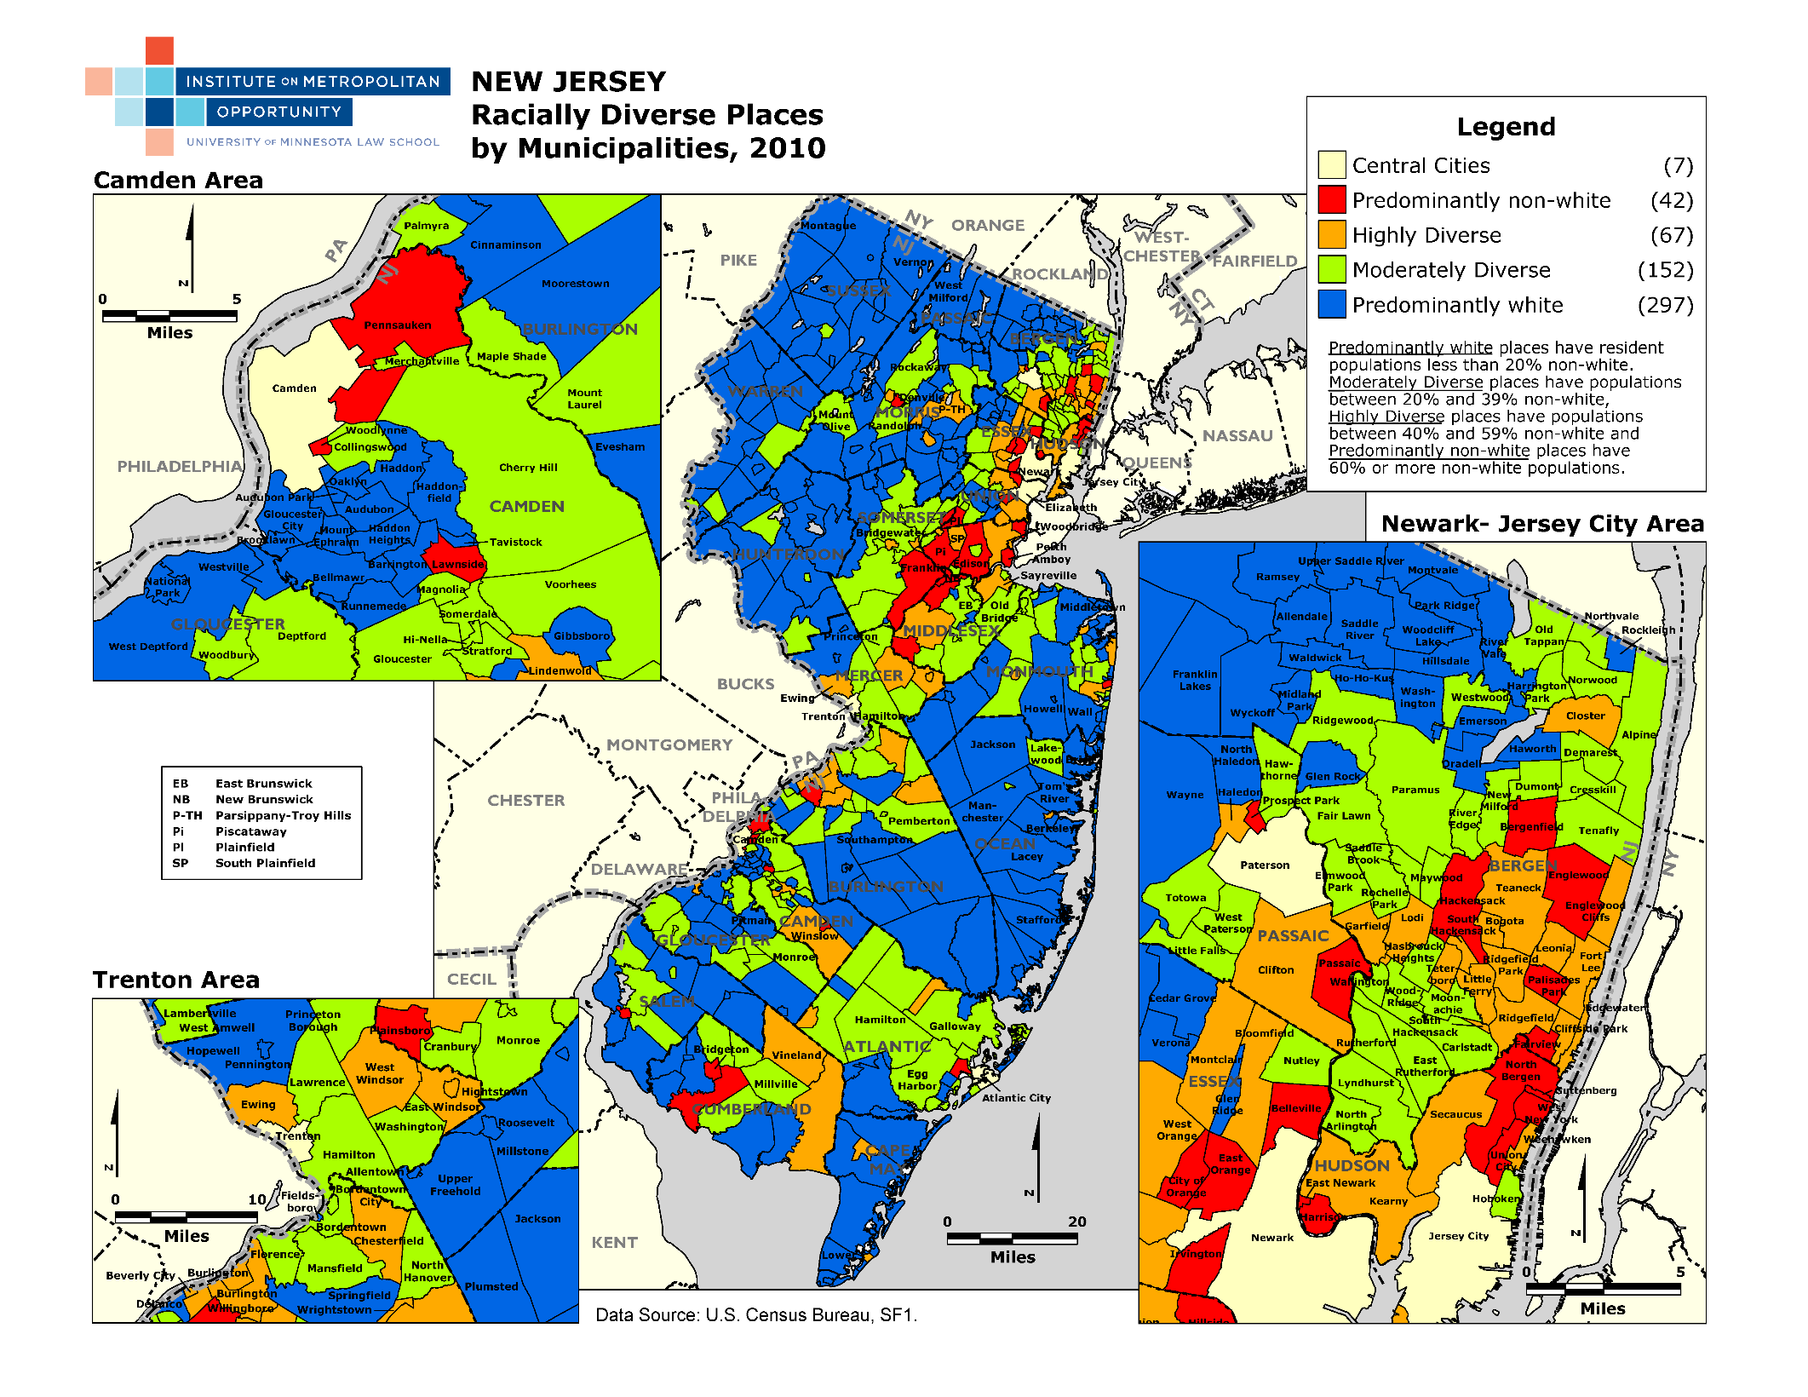

Slide 8
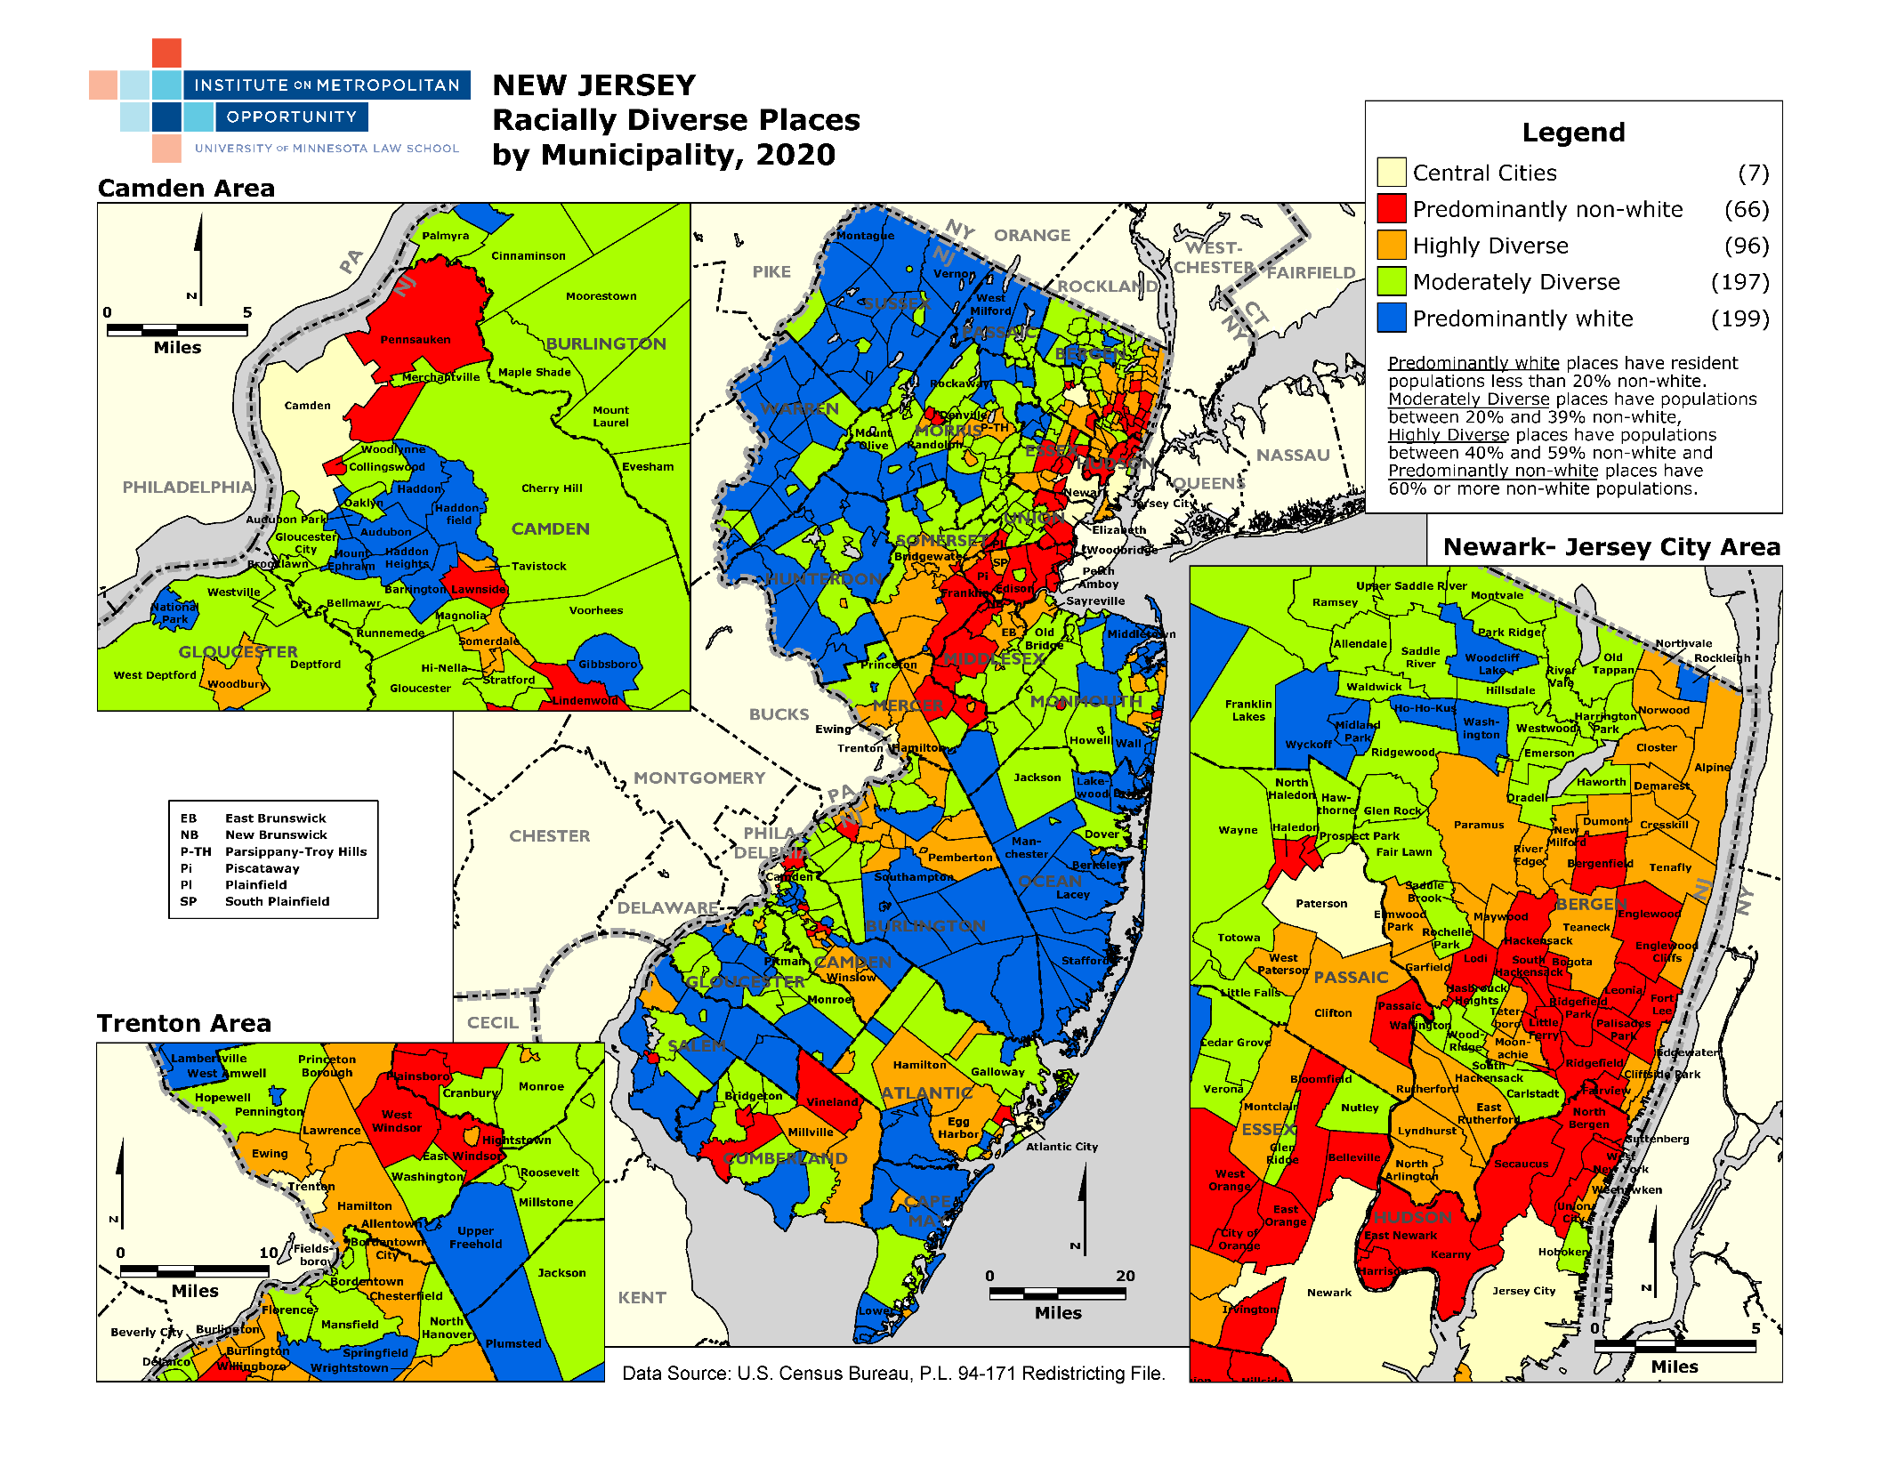

Slide 9
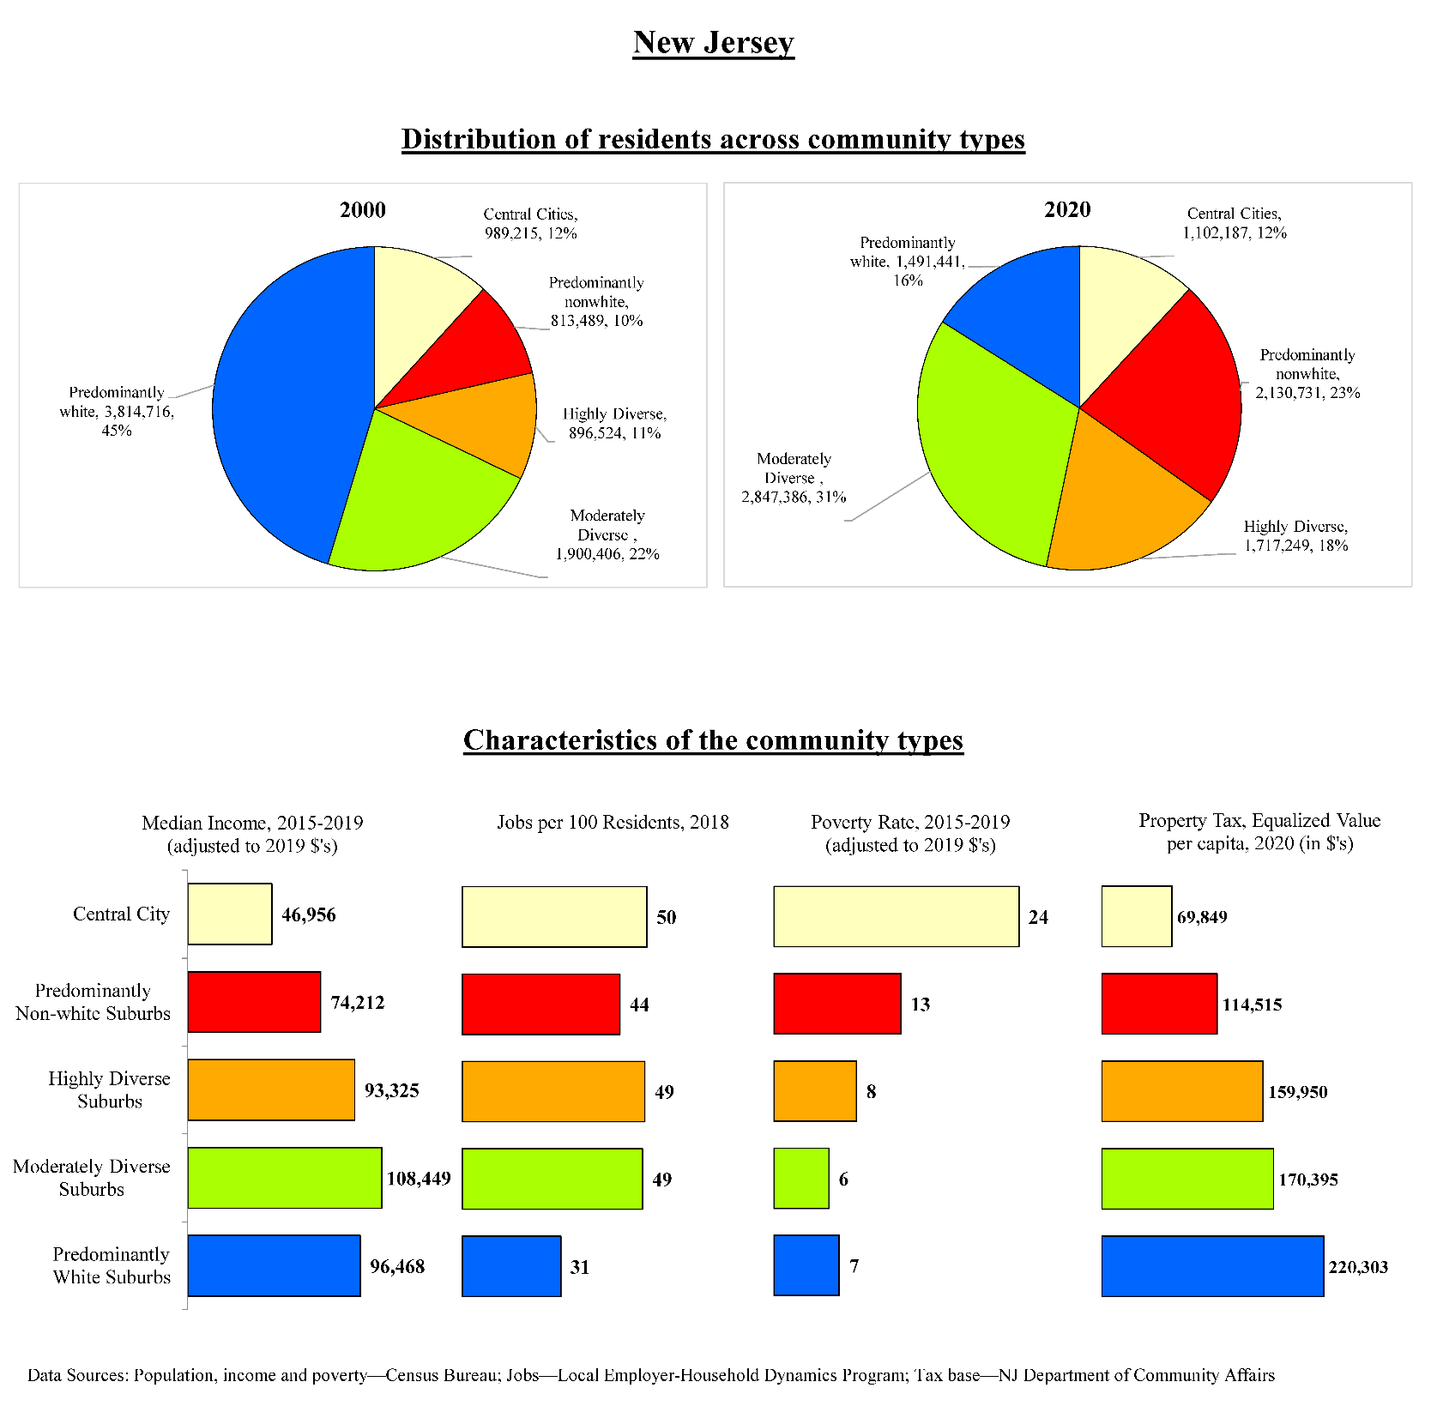

Slide 10
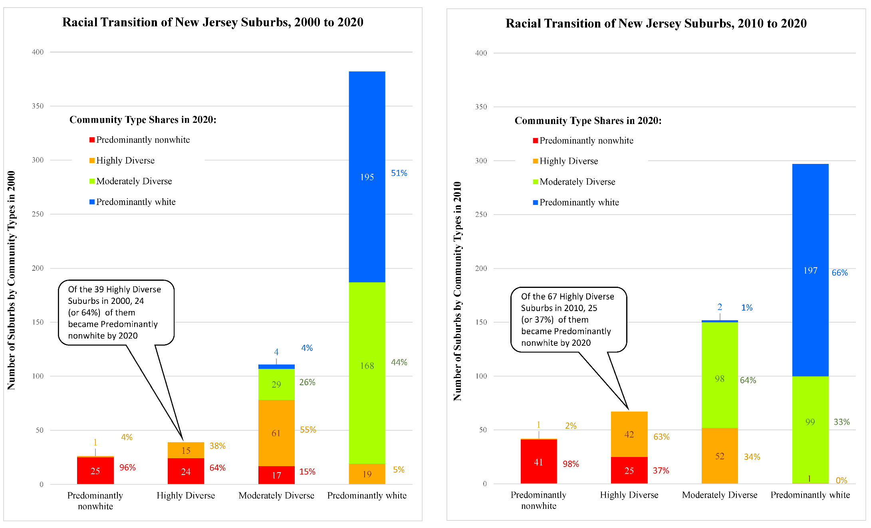

Slide 11
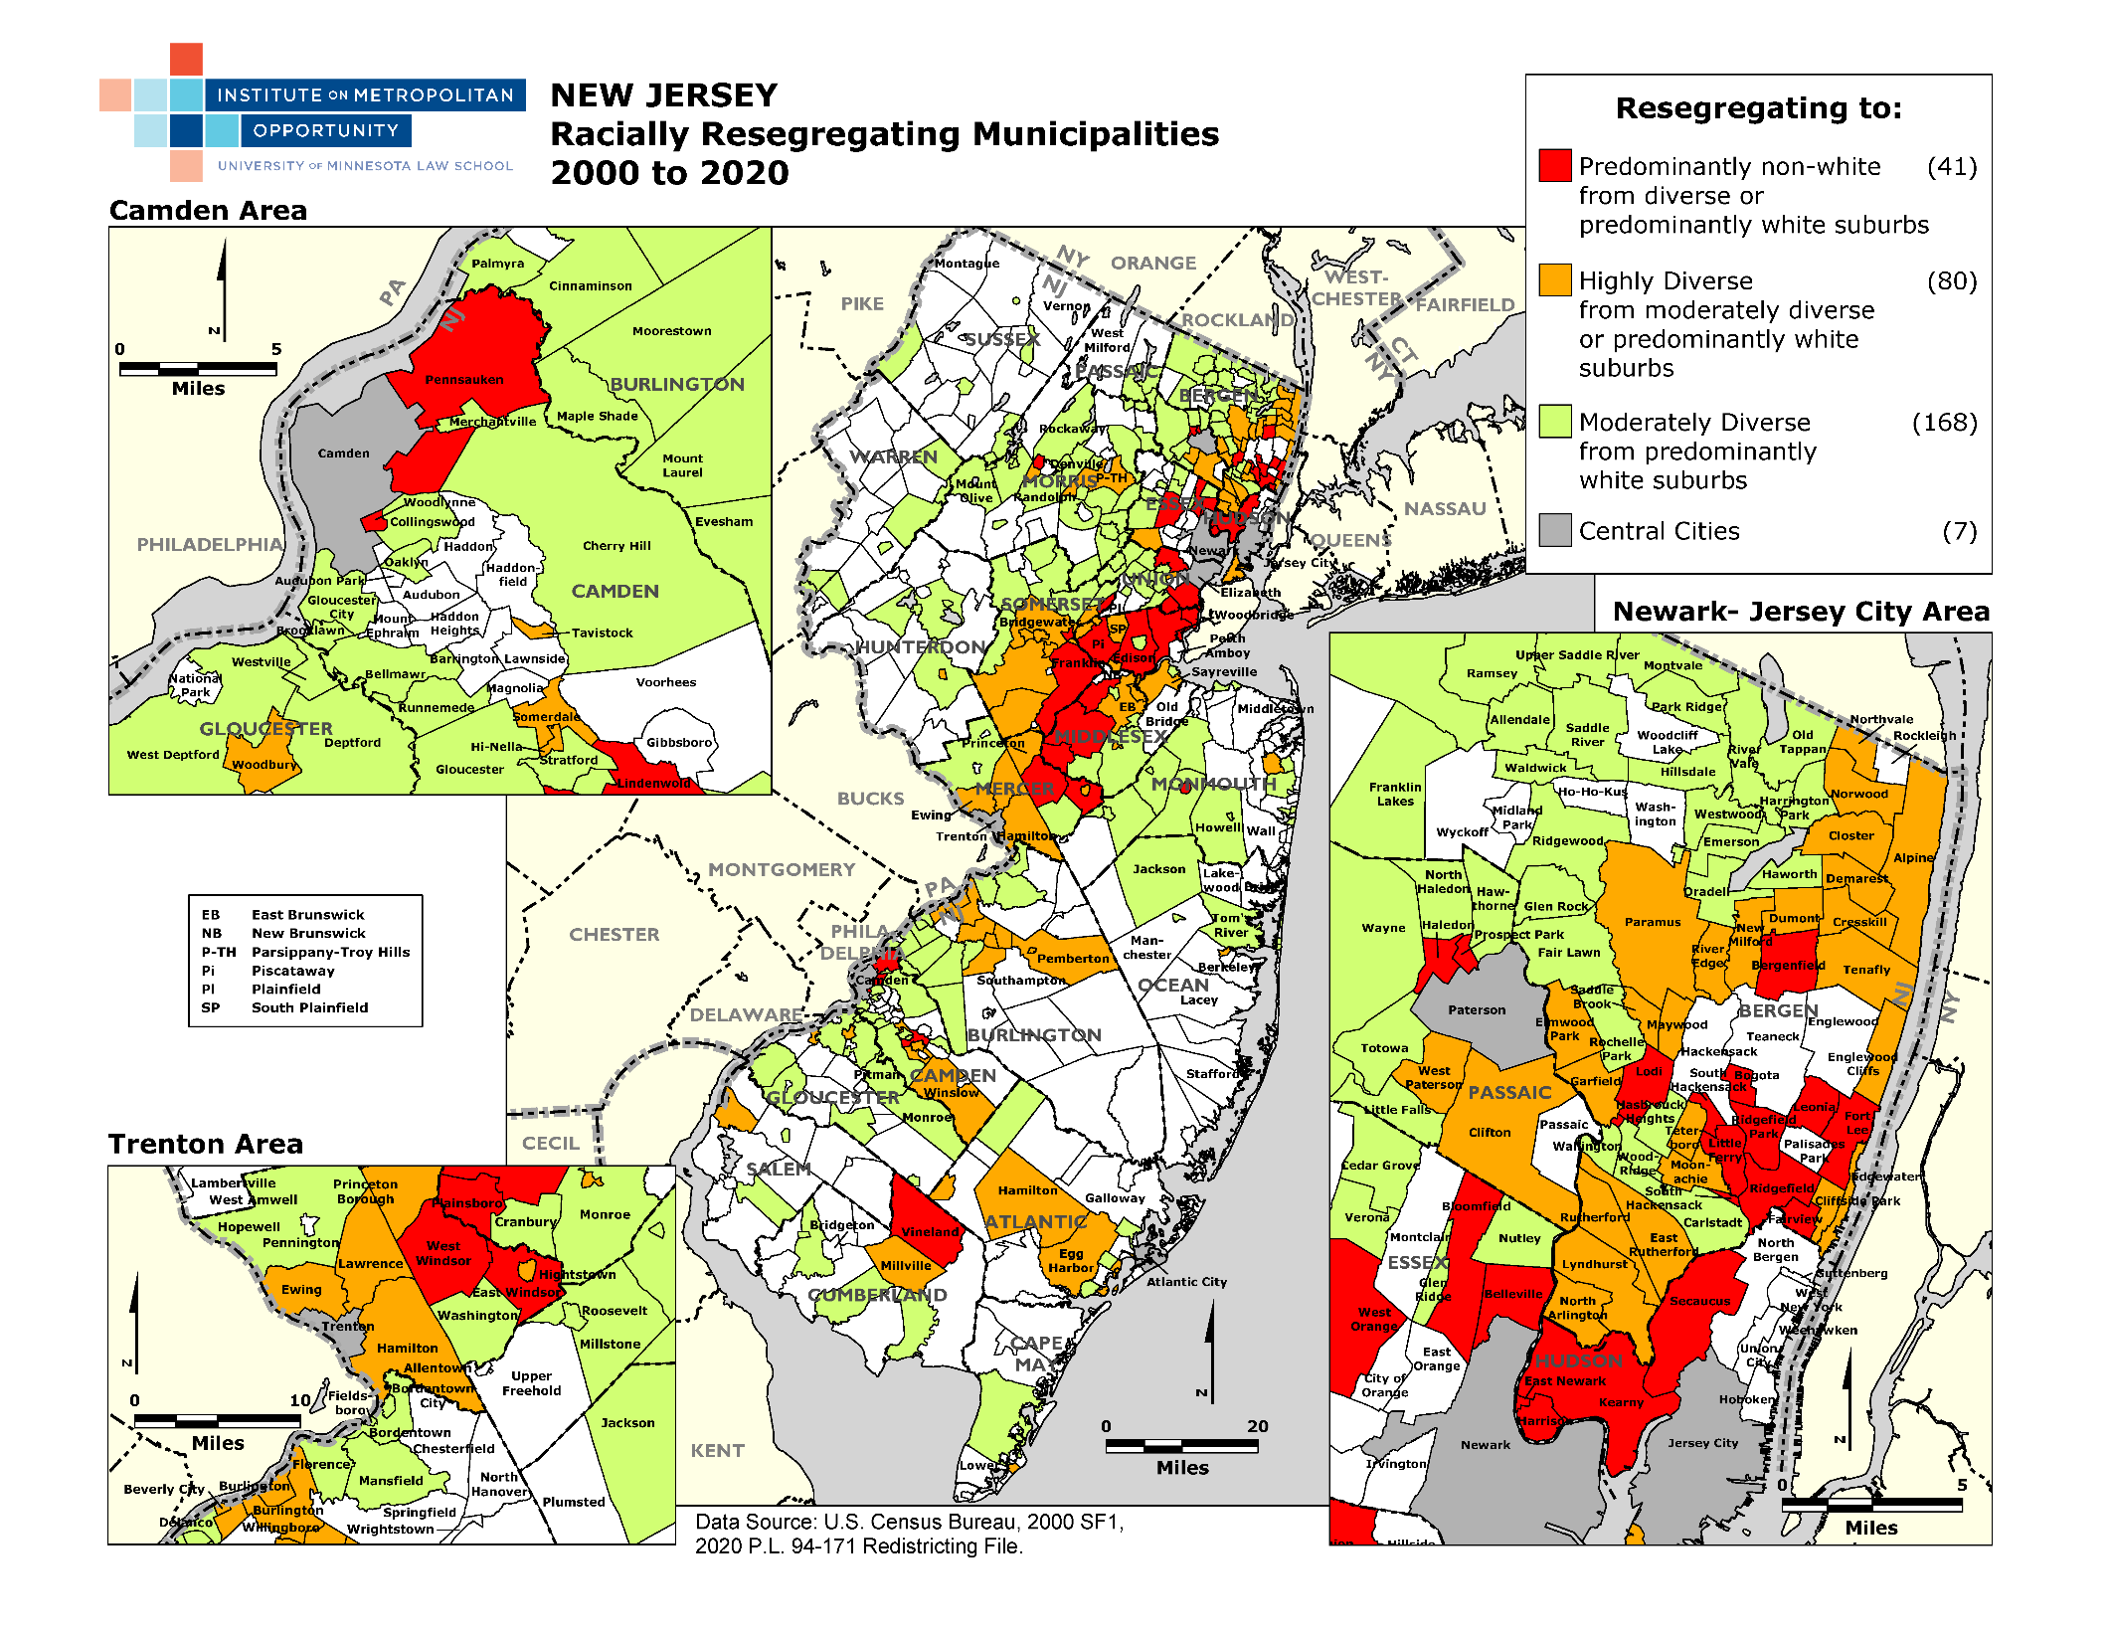

Slide 12
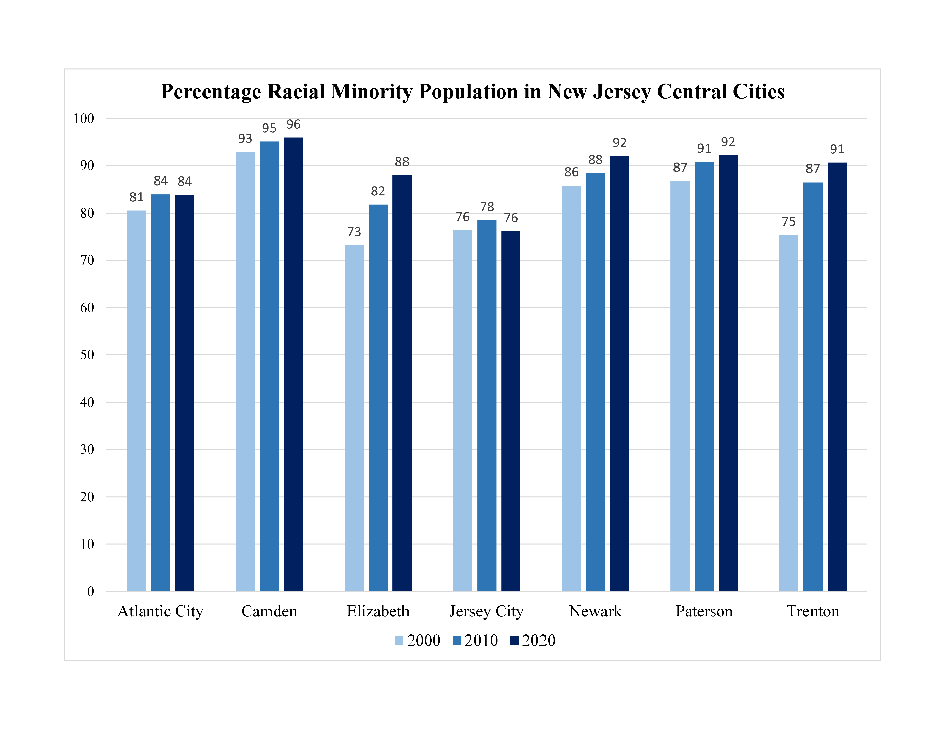

Slide 13
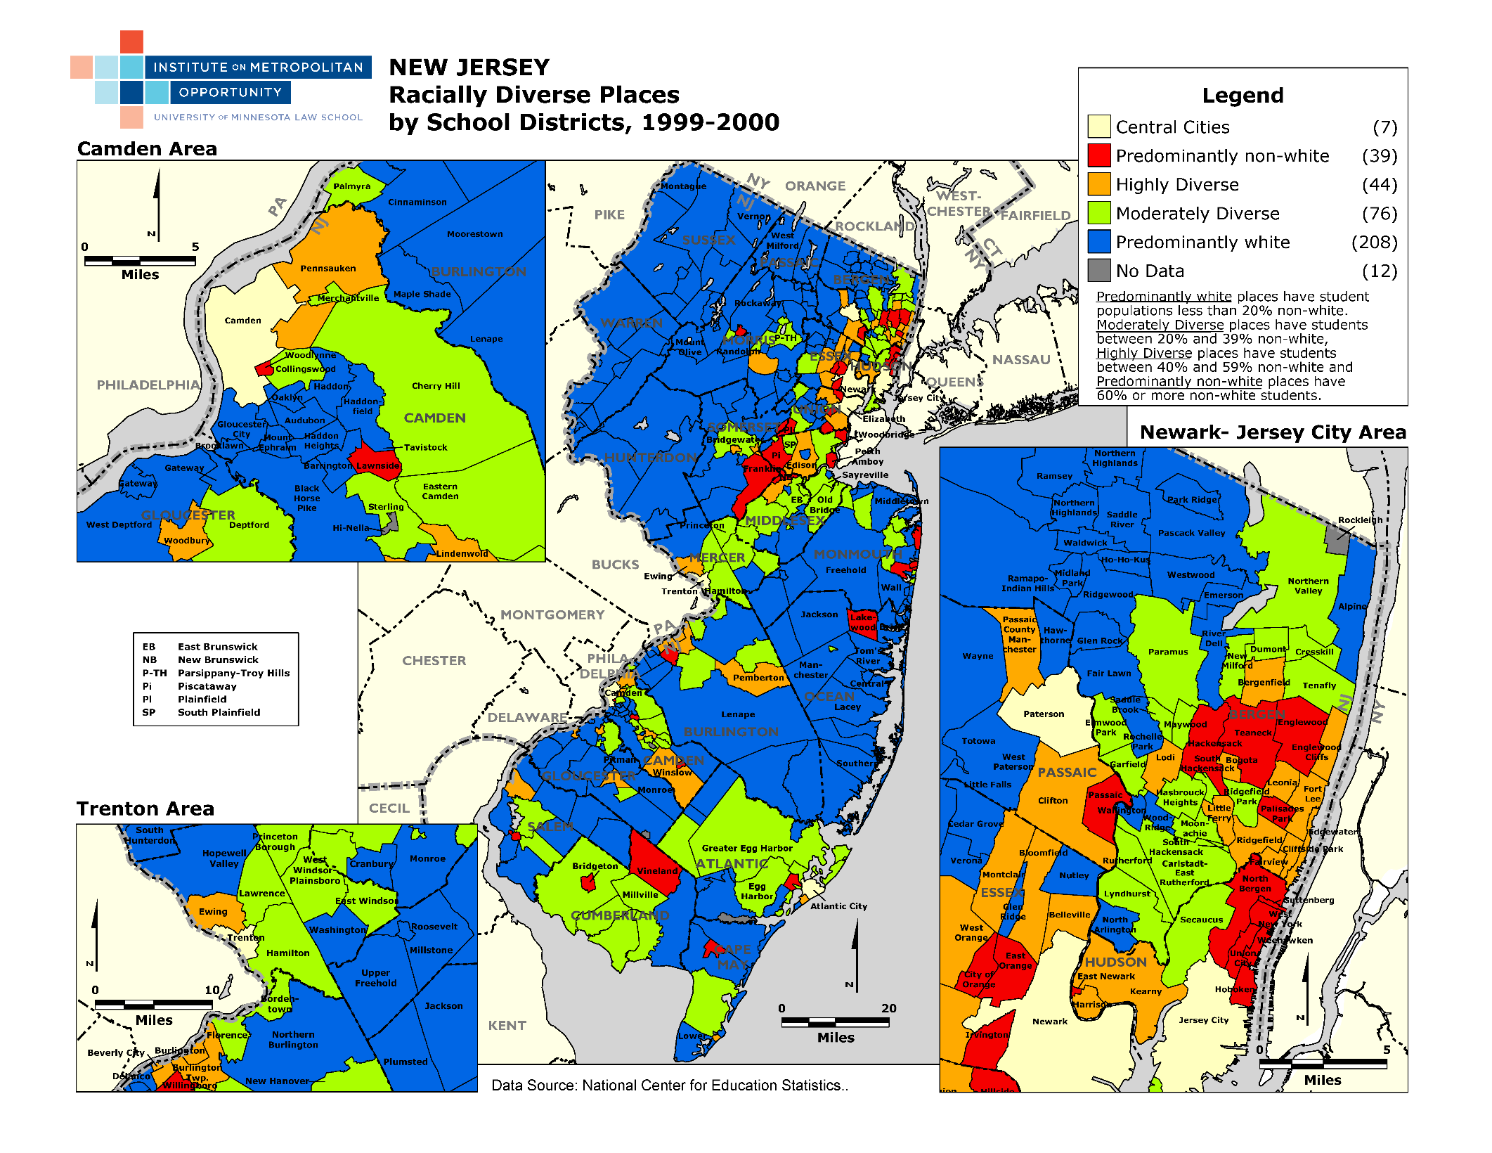

Slide 14
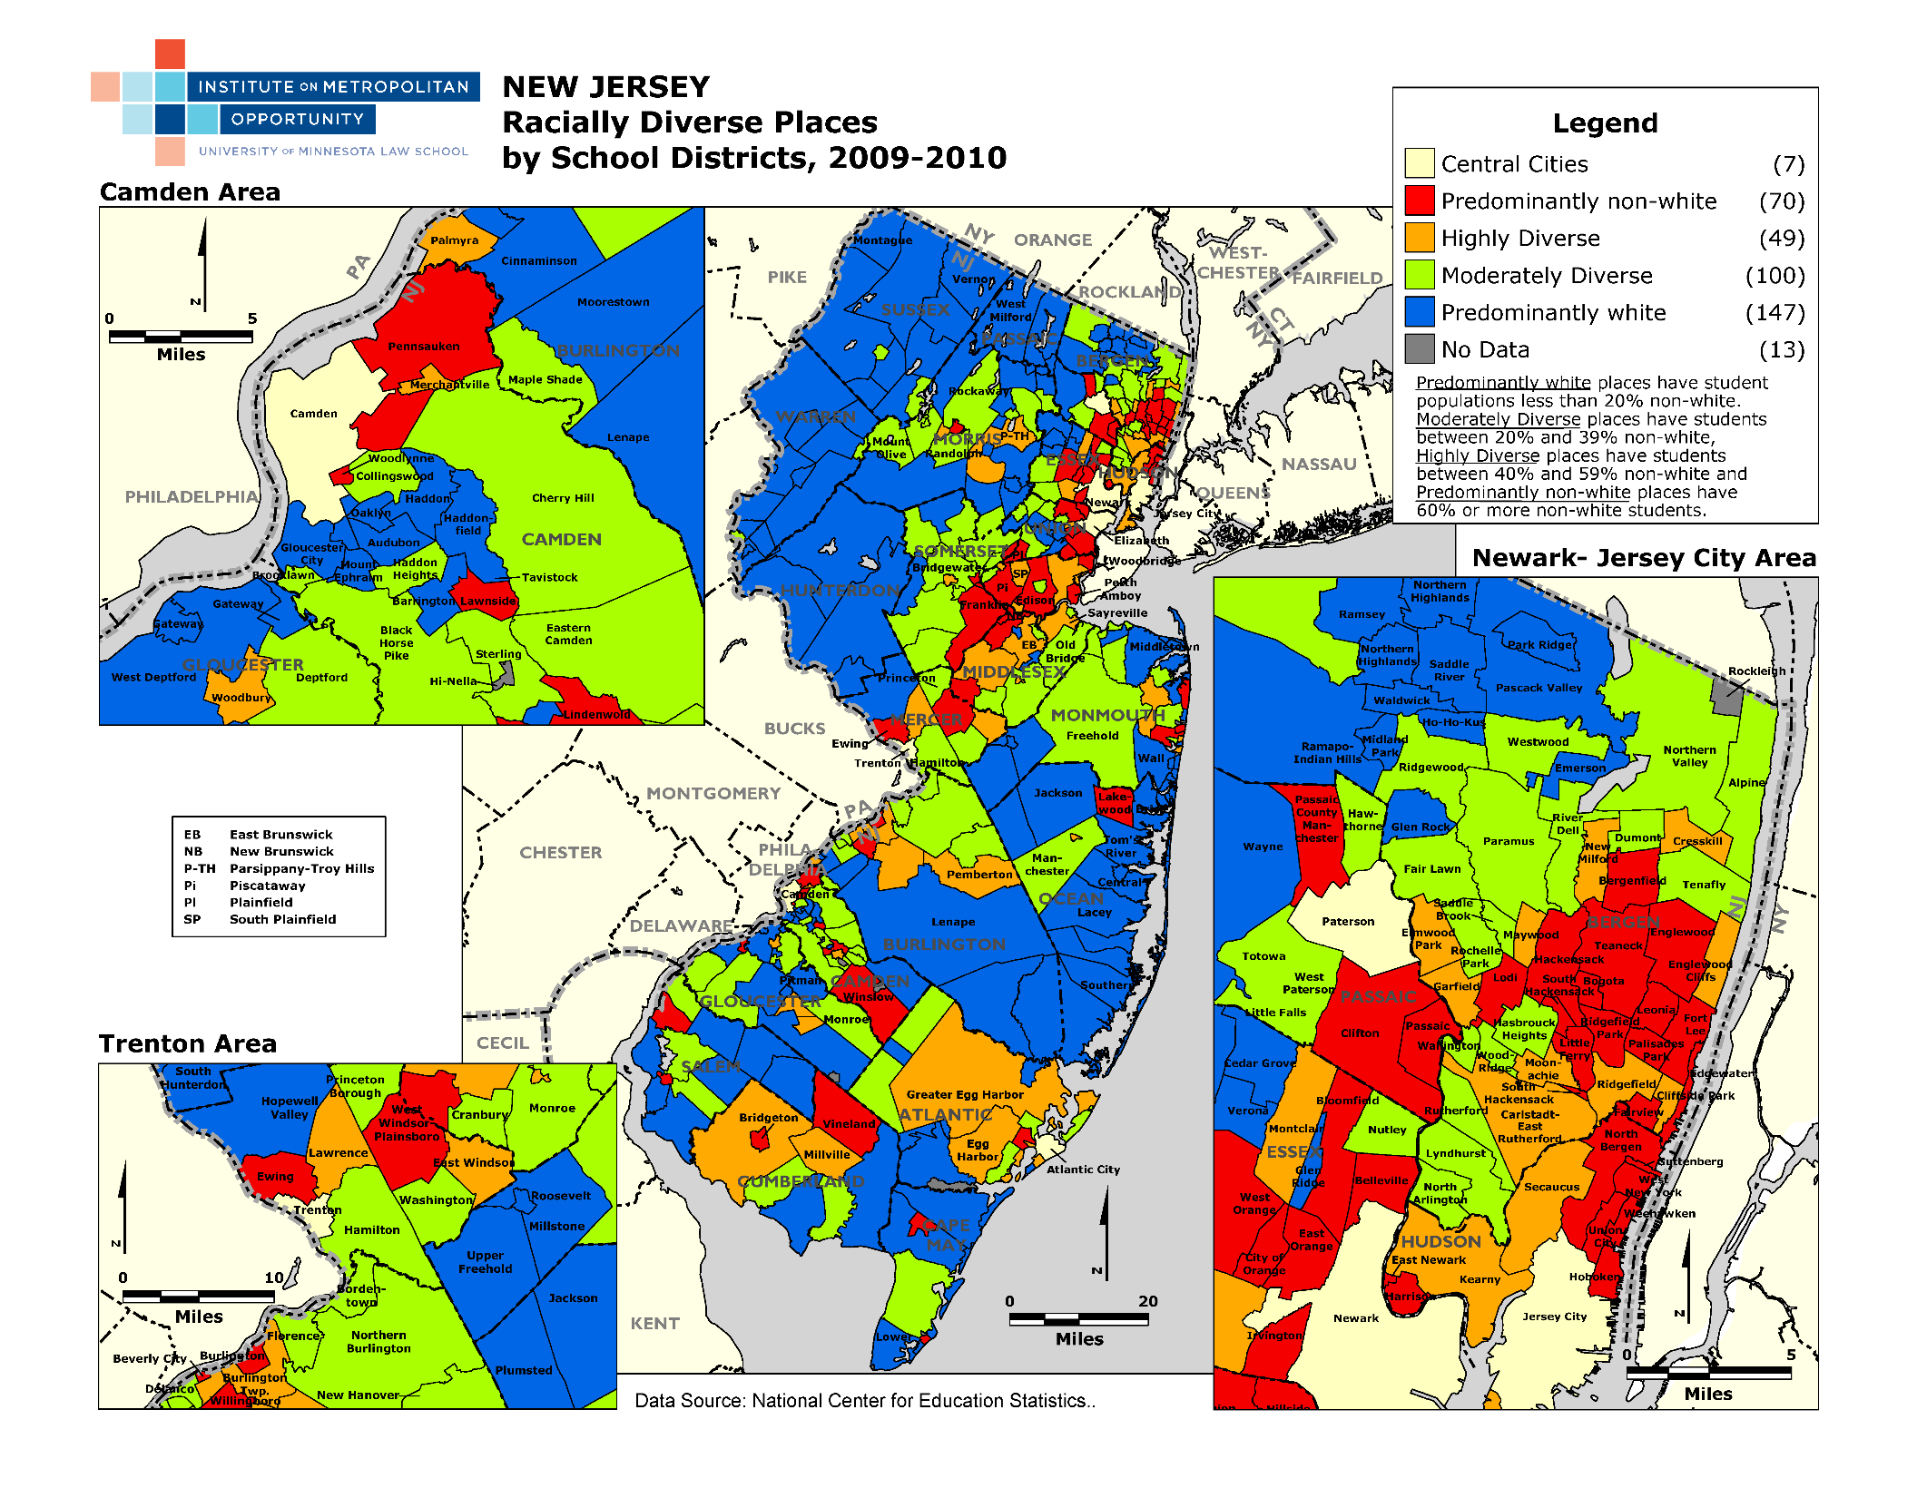

Slide 15
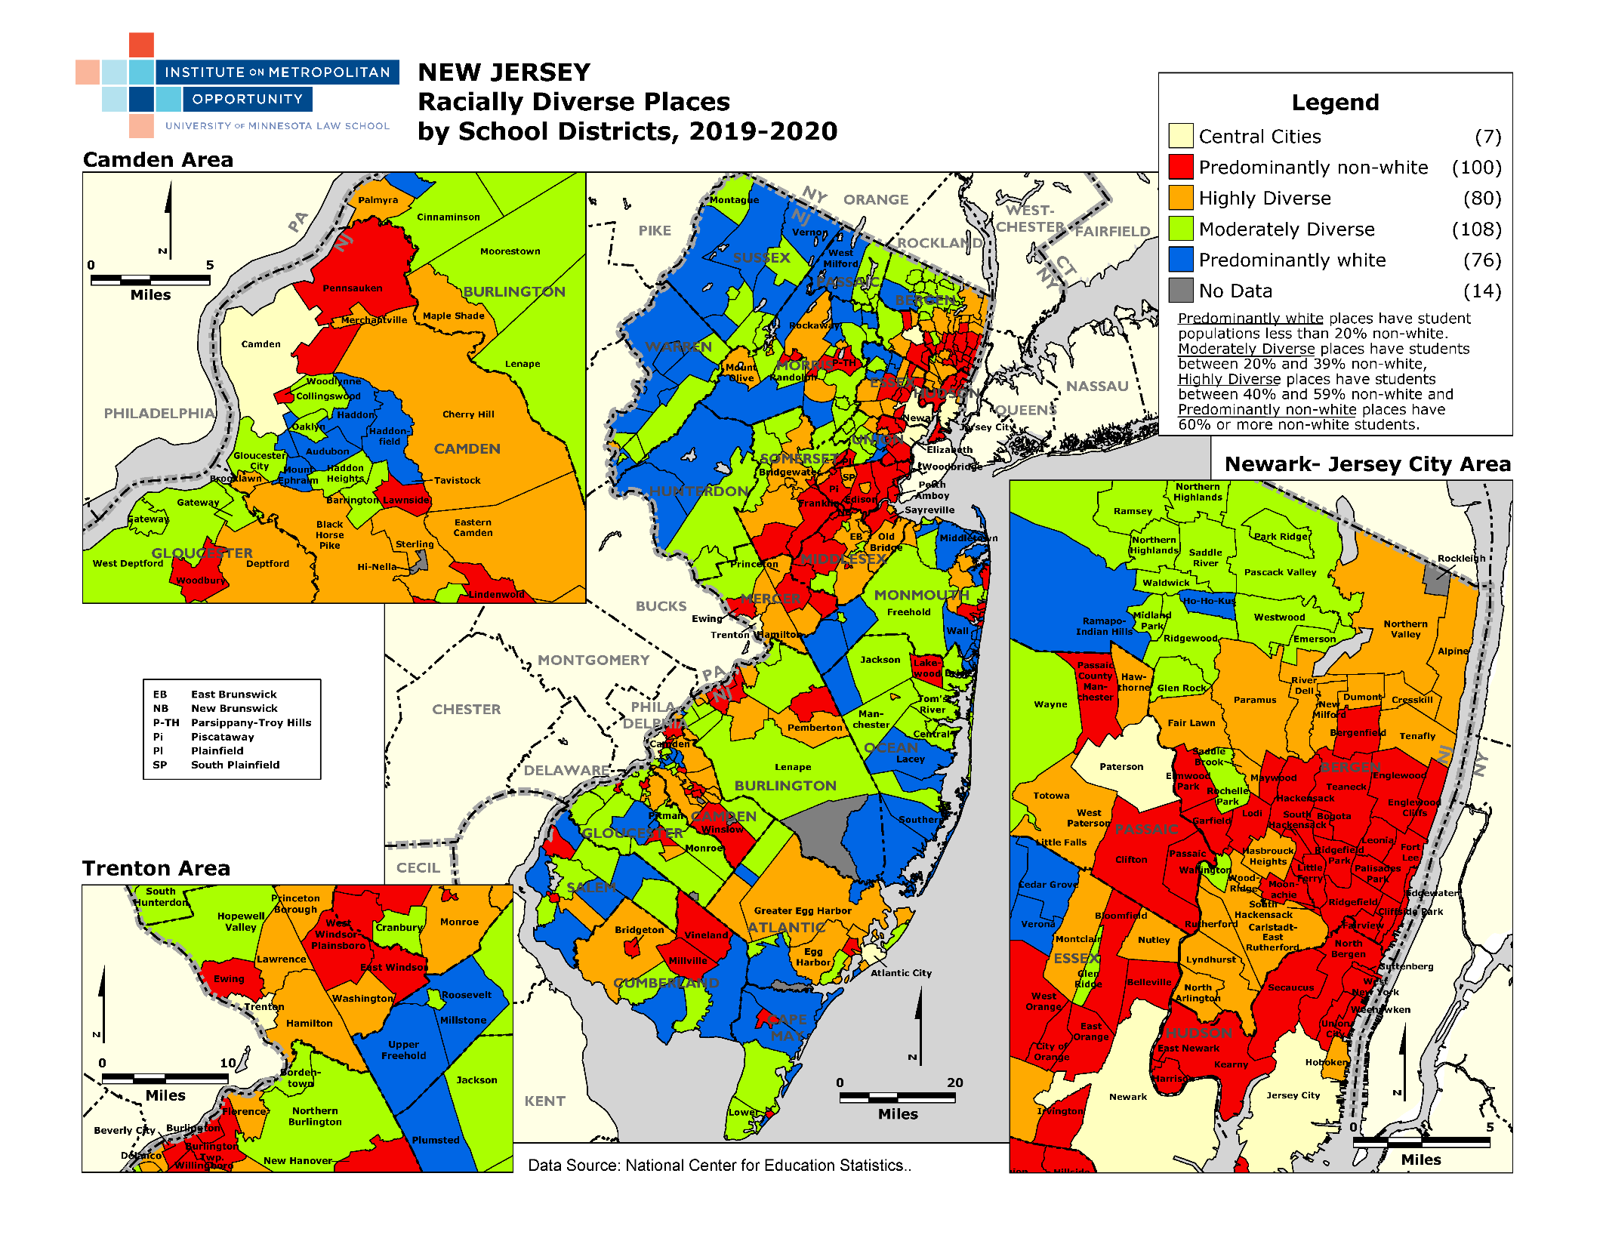

Slide 16
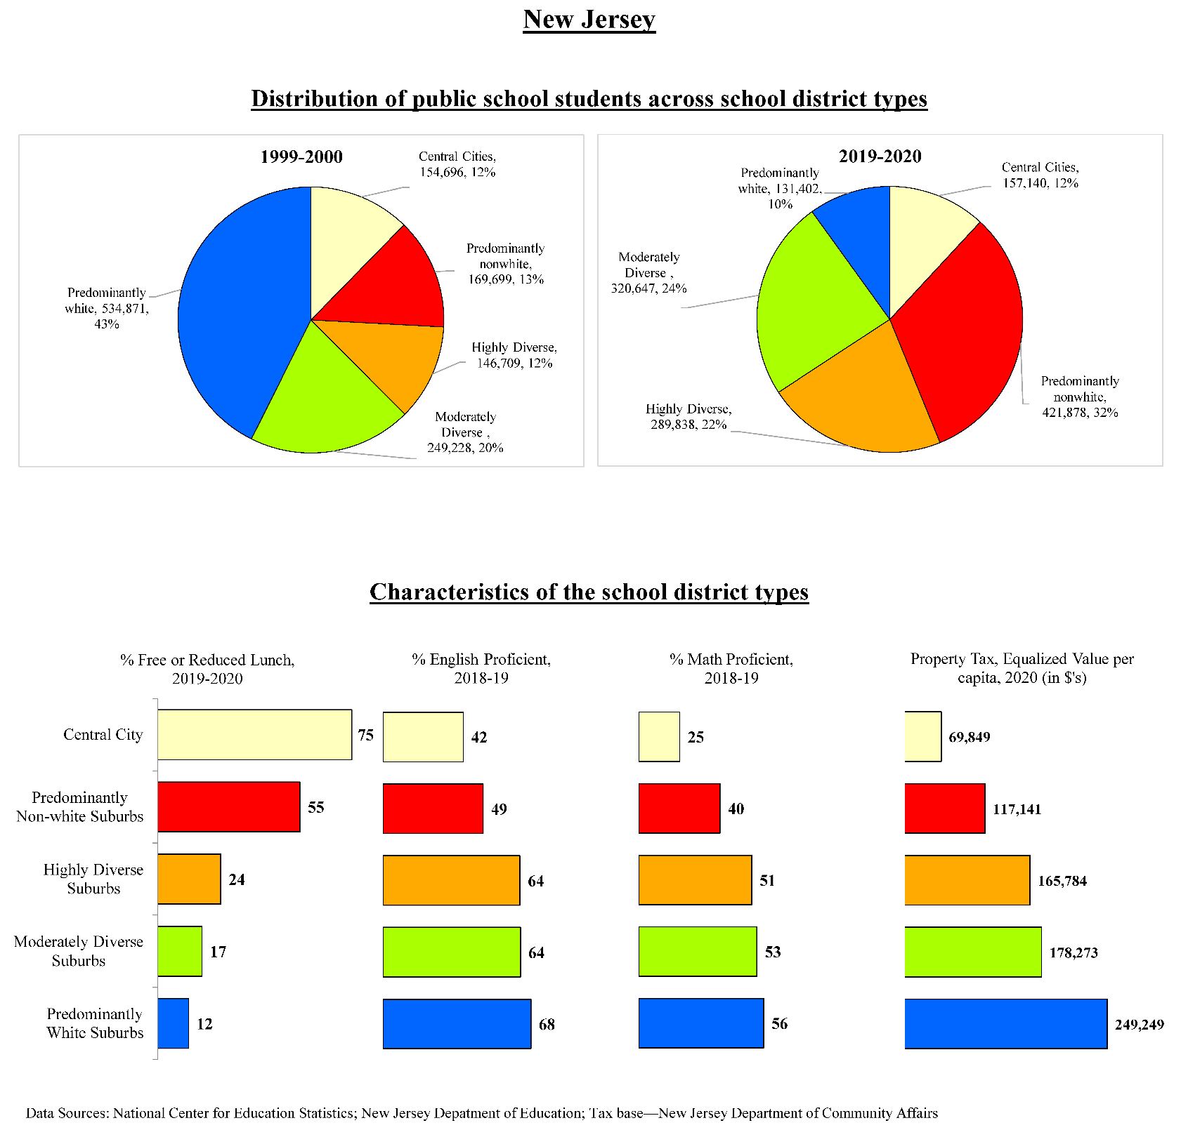

Slide 17
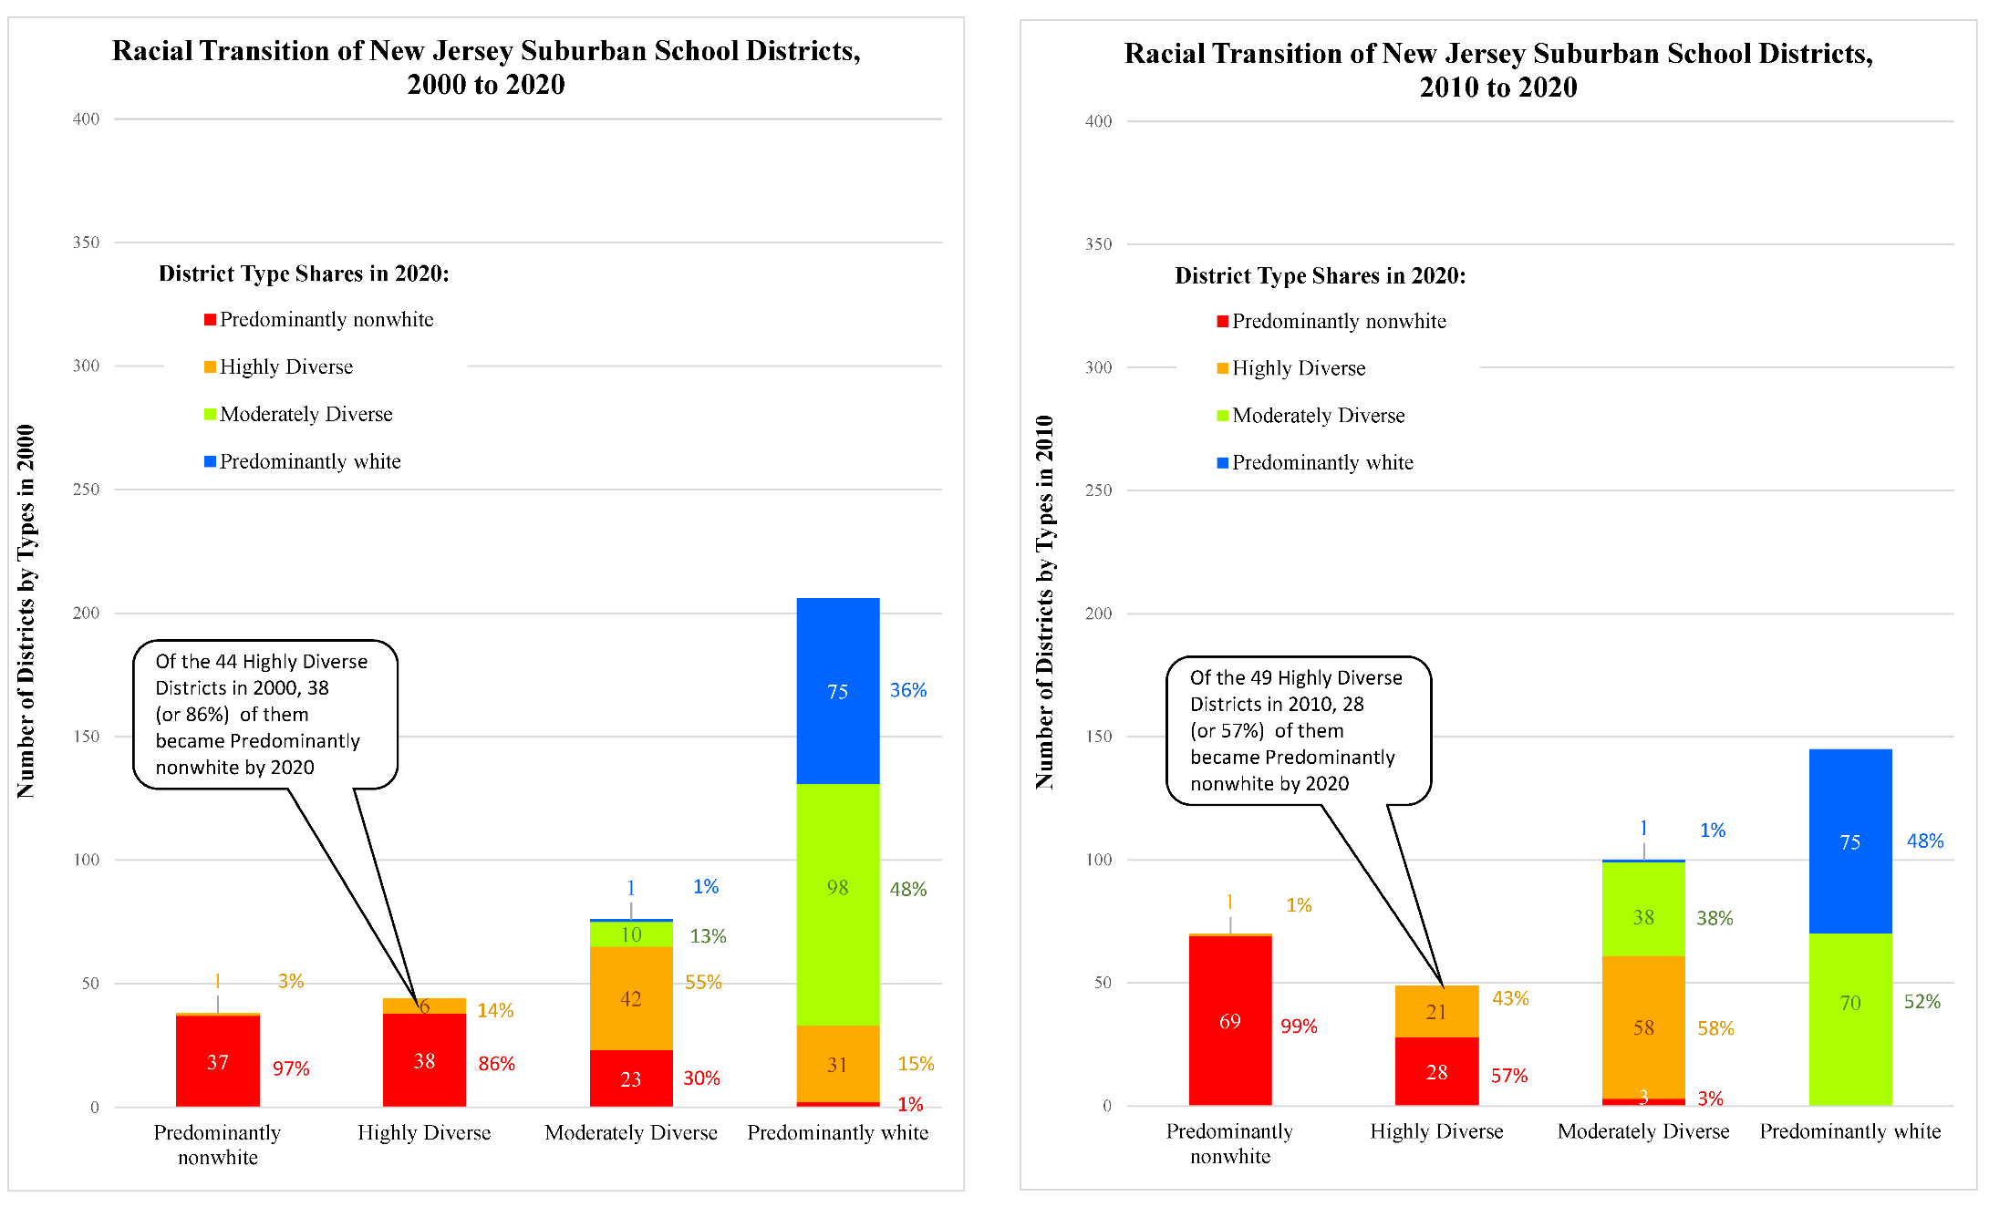

Slide 18
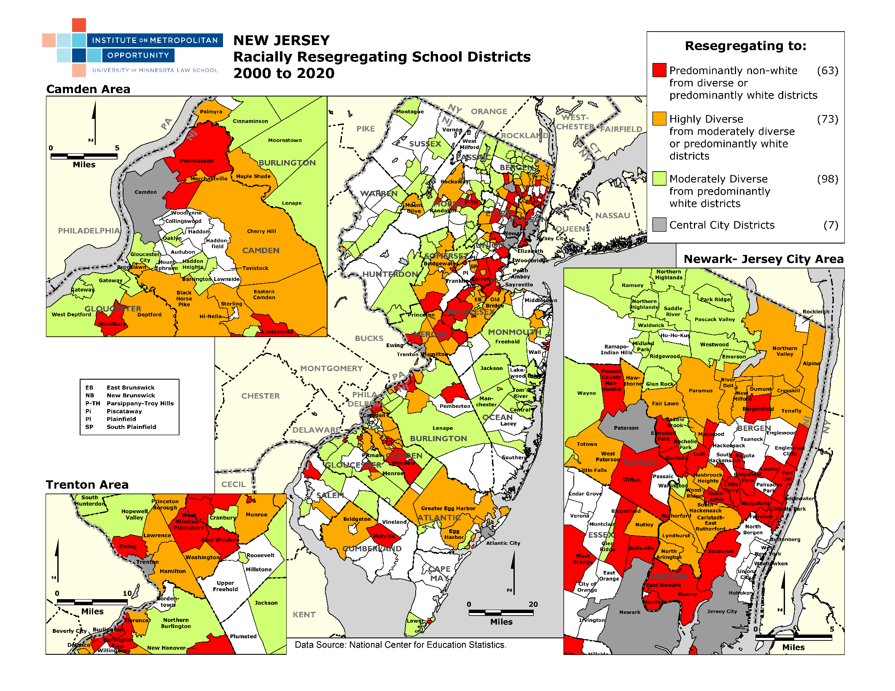

Slide 19
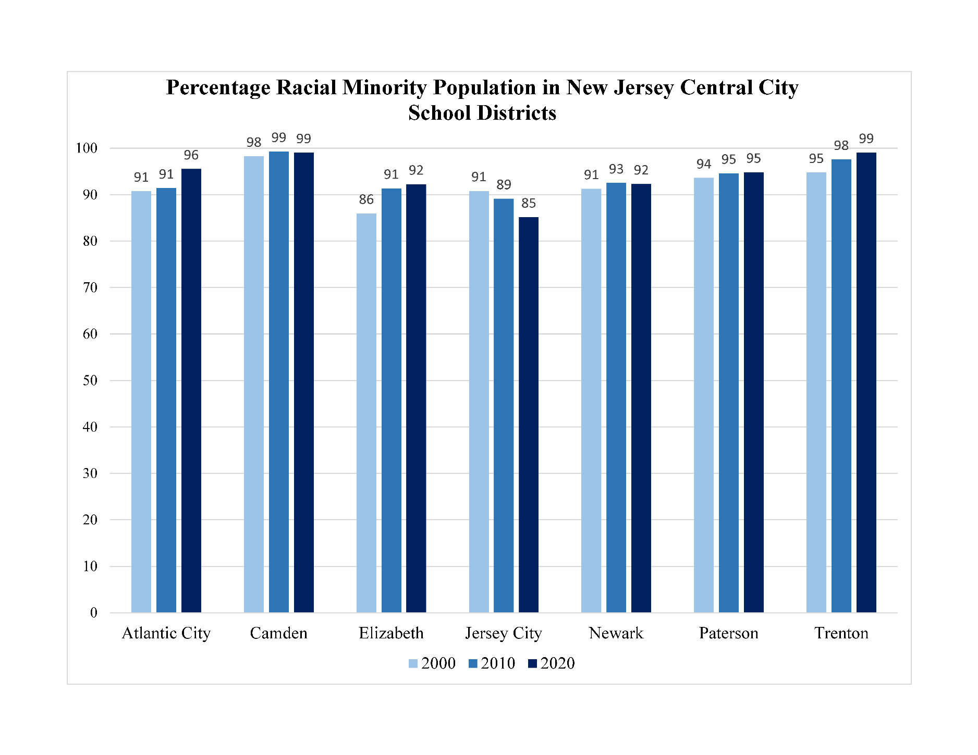

Slide 20
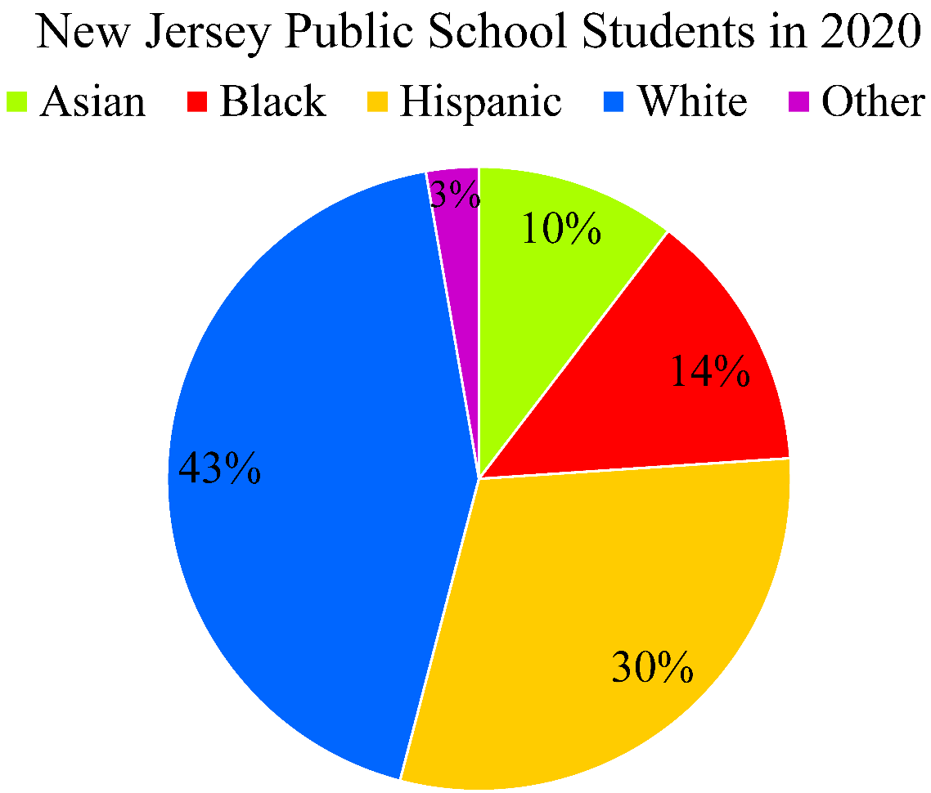
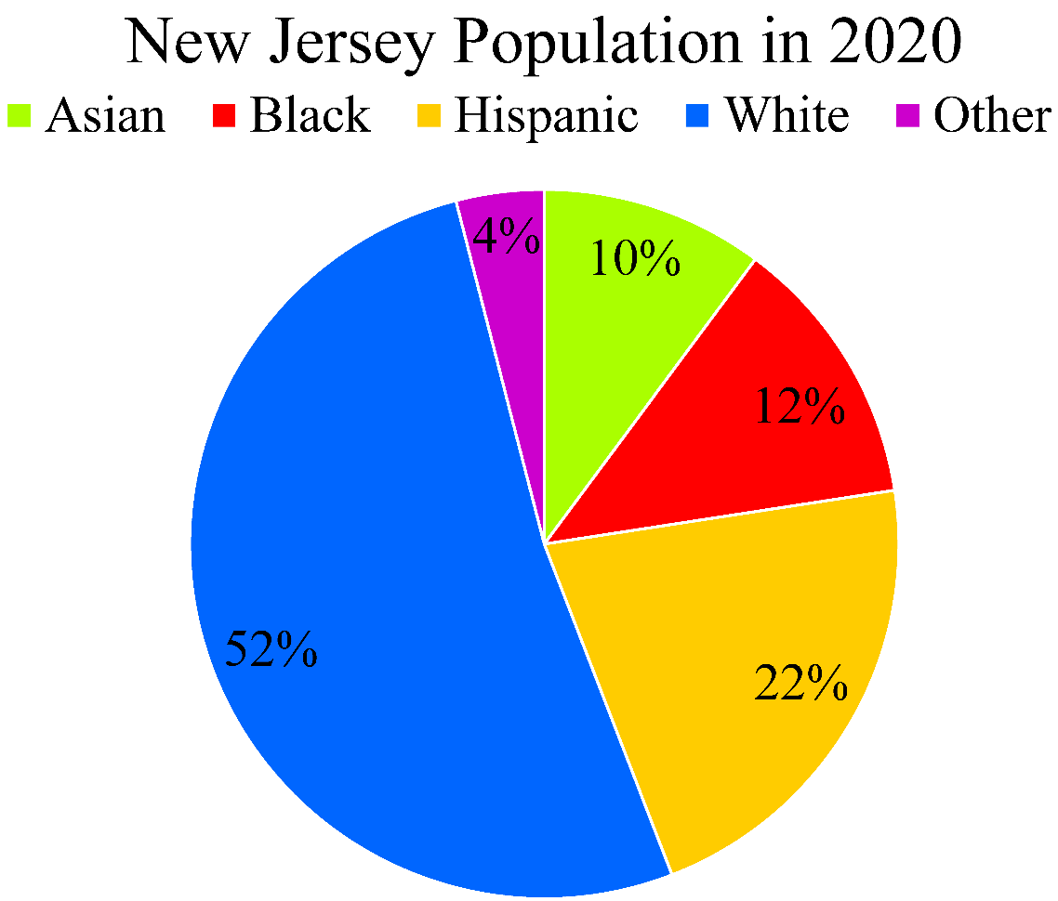

Slide 22
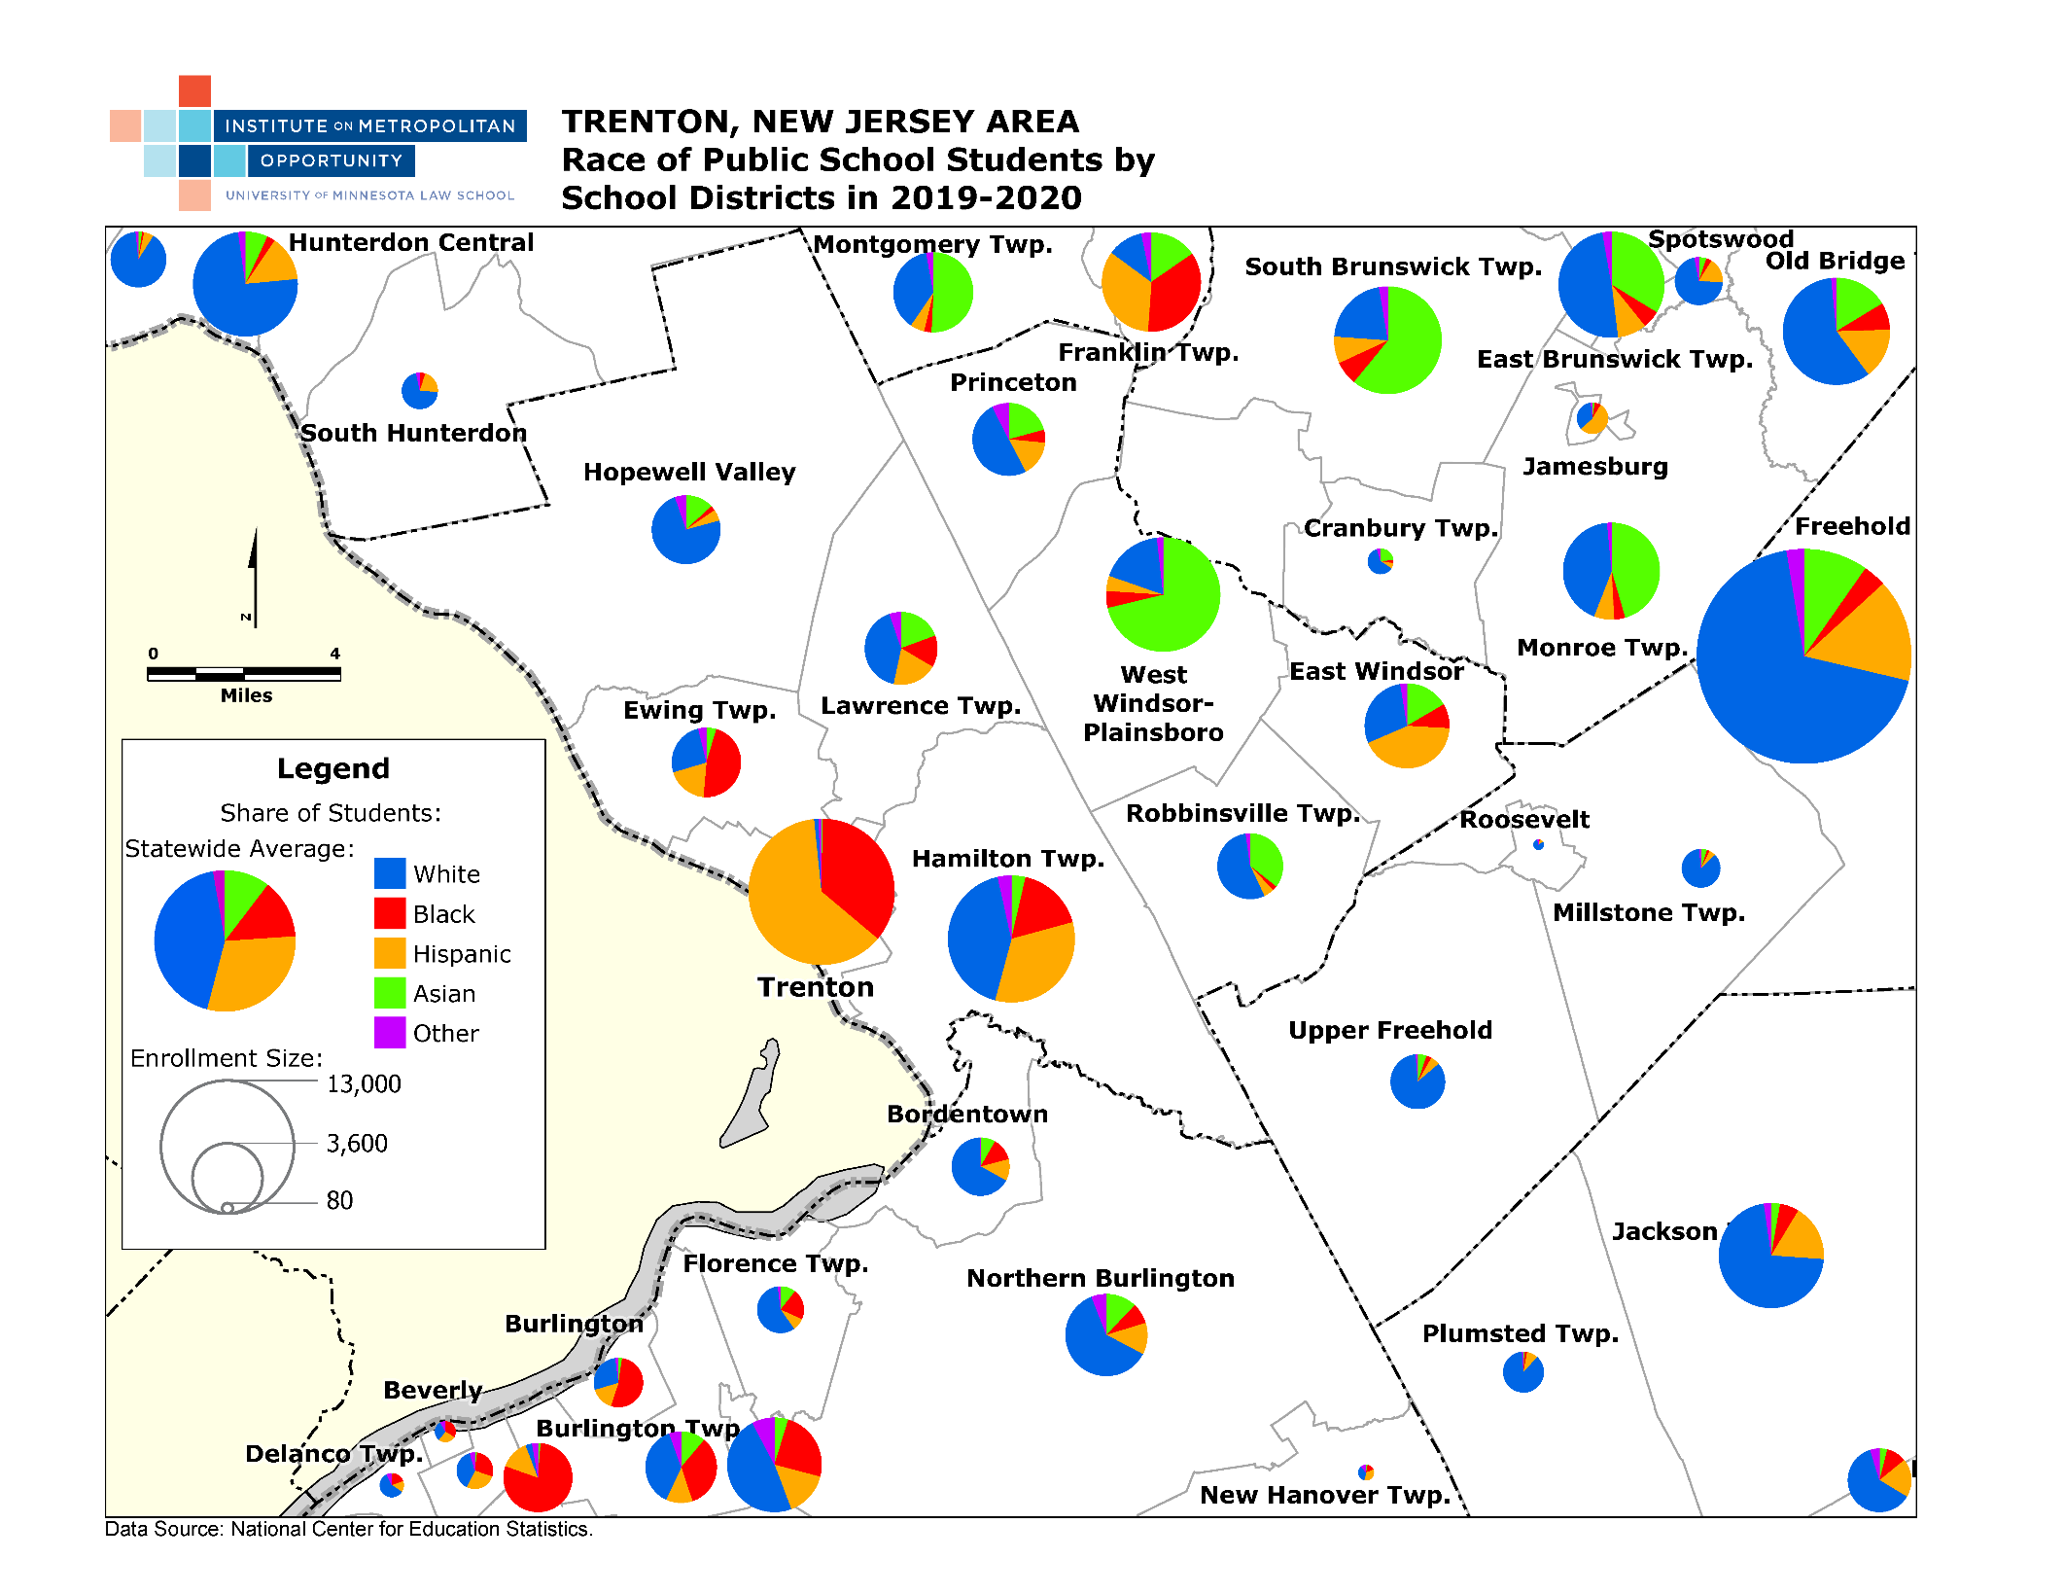

Slide 23
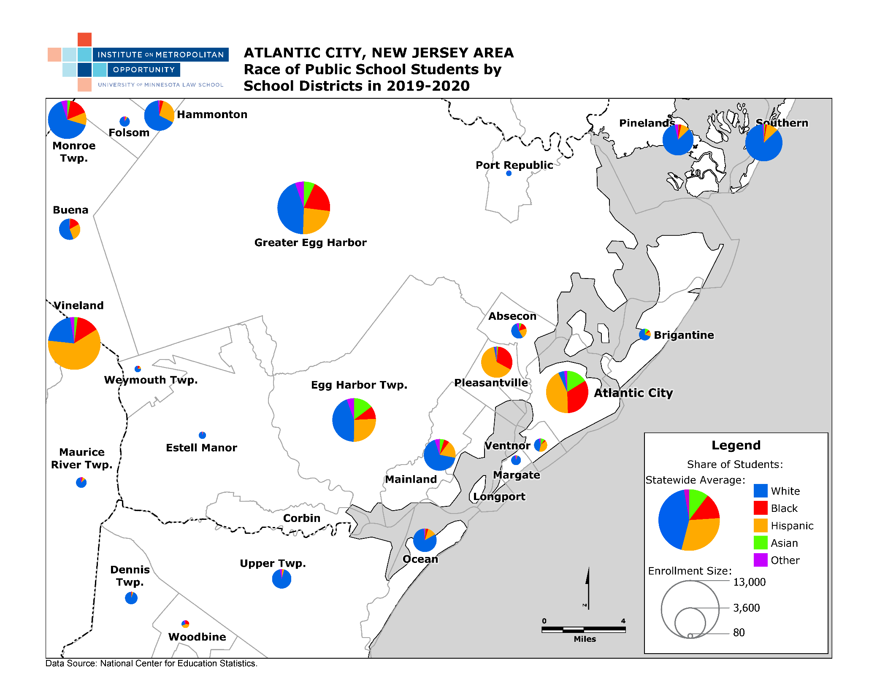

Slide 24
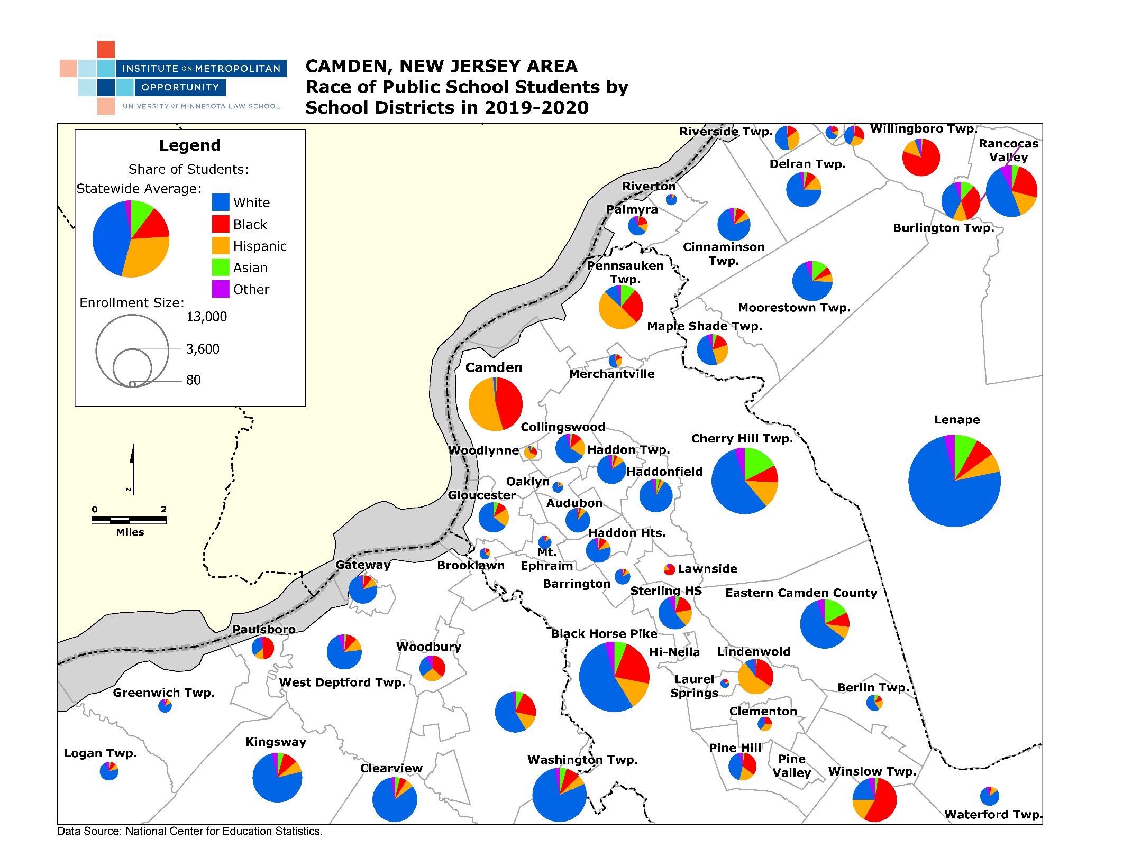

Slide 25
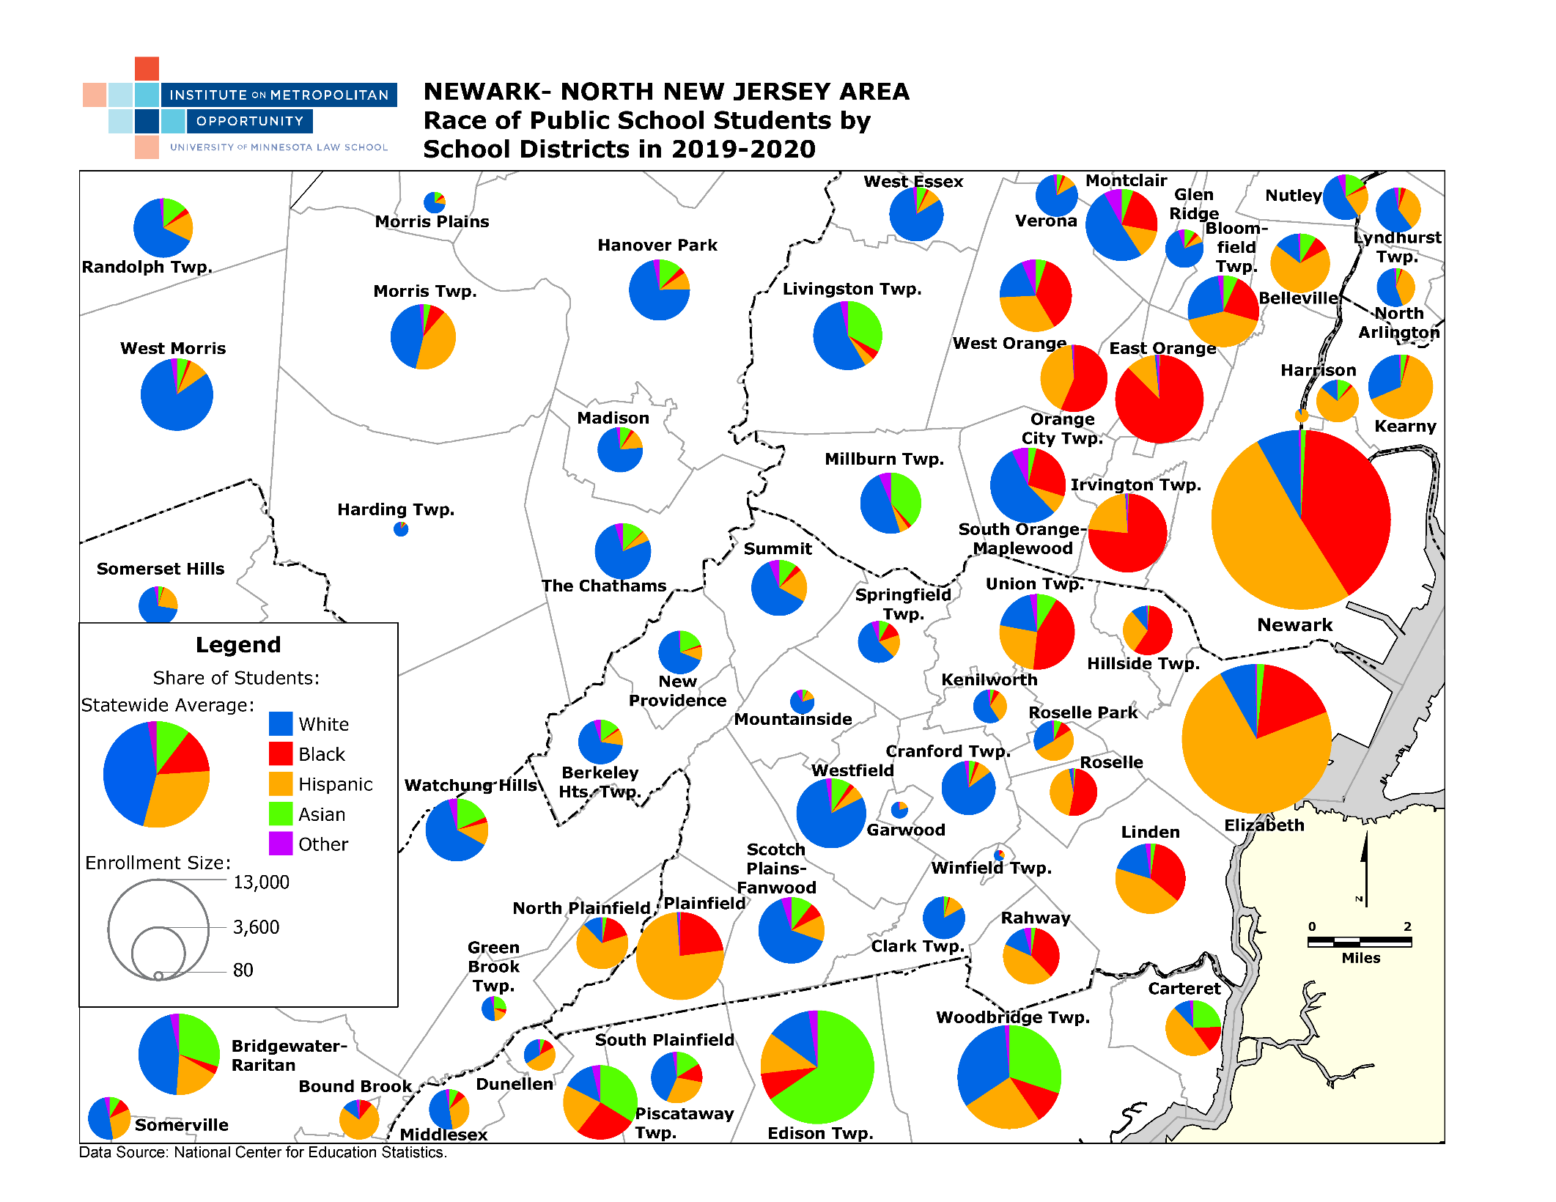

Slide 26
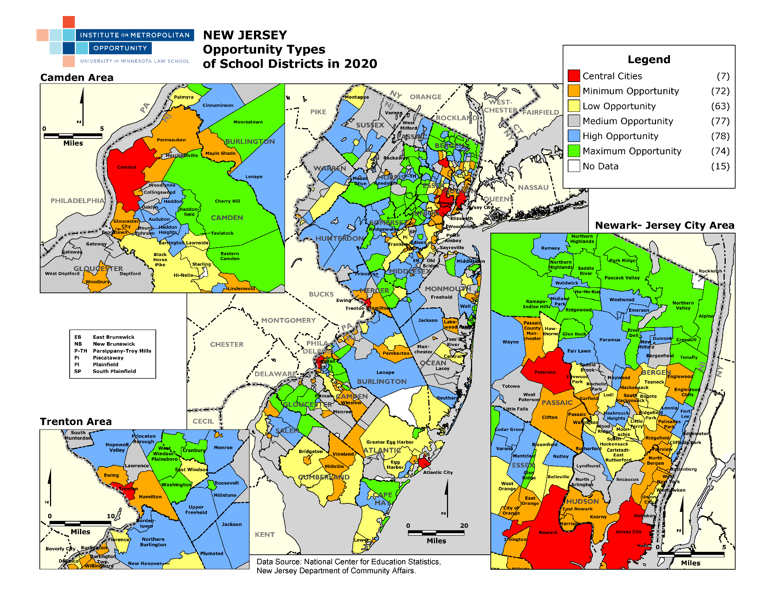
Notes:
This is an example of a metropolitan opportunity index (by school district). It measures opportunity using factors including % of Free & Reduced School Lunch, % of students proficient in Math & Reading, Per Pupil-Property Tax Capacity. Green & Blue areas are the highest opportunity communities with very few low-income students, best scores & highest ratable base. Highest opportunity school districts would have the greatest obligation to meet regional diversity & integration goals.

Slide 27
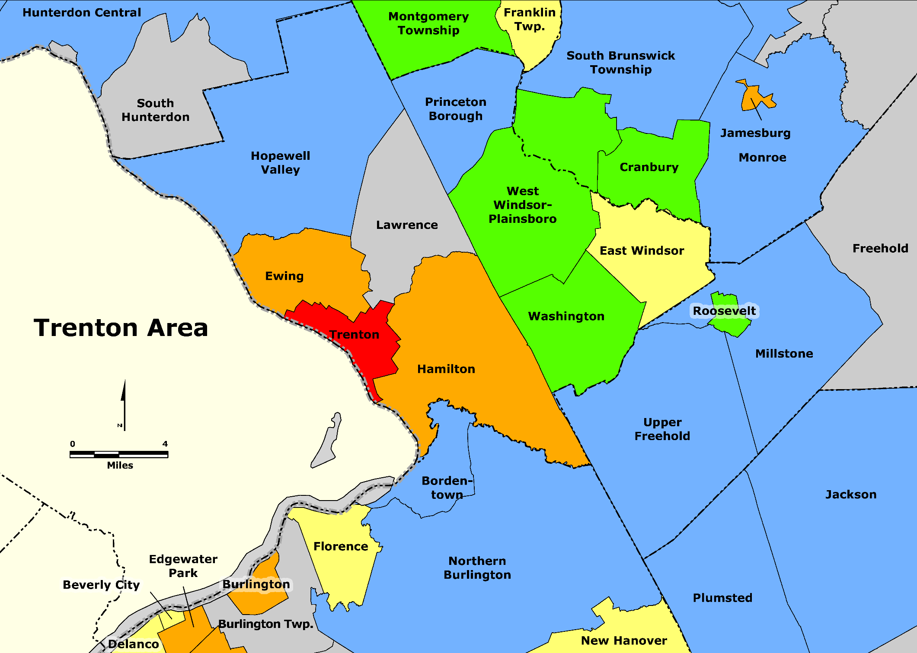

Slide 28

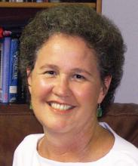
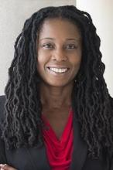
PART II
Why Should
We Care?
The damage to the segregated
and the harm to us all
Michelle Burris (Moderator), Century Foundation
Jonathan Kozol,
Writer, educator, & activist
Erika K. Wilson,
University of North Carolina's School of Law
Linda Darling-Hammond, President of the Learning Policy Institute

Slide 29
Keith Ellison
Attorney General of Minnesota
A Message from the Honorable Keith Ellison, Attorney General of Minnesota,
former member of United State Congress,
Chair of the Congressional Progressive Caucus.
“Your cause is just & it’s winnable”

Slide 30

INSTRUCTIONS FOR WORKING LUNCH
Instructions for Working Lunch
Group by Region - Try to group by legislative districts or contiguous clusters of districts.
Select your LUNCH
Discuss - share feedback on presentation so far.
Review - upcoming policy proposals.
Immediate Action – create plan to engage your district legislators, Governor, Education Commissioner etc. until November 2nd.
Choose Leader - to report back after lunch.

Slide 32
Community Organizing Districts
Atlantic / South Shore Organizing District *
Legislative Districts: 1, 2
Counties: Cape May, Cumberland, Atlantic
Capitol Region Organizing District *
Legislative Districts: 14, 15
Counties: Mercer, Middlesex
Key Legislators: Turner, Greenstein, DeAngelo
Hudson River Organizing District
Legislative Districts: 31, 32, 33, 35, 36, 37, 38
Counties: Hudson, Bergen
Key Legislators: Cunningham
Jersey Shore Organizing District
Legislative Districts: 11
Counties: Monmouth
* Established organizing capacity
Lower Delaware Organizing District *
Legislative Districts: 6, 7
Counties: Camden, Burlington
Key Legislators: Beach, Lampitt
Mid Jersey Organizing District
Legislative Districts: 16, 17, 18, 19, 22
Counties: Somerset, Hunterdon, Middlesex
Key Legislators: Coughlin
Northeast Region Organizing District *
Legislative Districts: 20, 21, 22, 27, 28, 29, 34, 35, 38
Counties: Union, Essex, Passaic
Key Legislators: Ruiz, Cryan, Jasey, Caputo, Rice, Wimberly
Southern Region Organizing District *
Legislative Districts: 3, 4, 5
Counties: Salem, Gloucester, Cumberland, Camden
Key Legislators: Sweeney, Burzichell

Slide 33

BREAK FOR LUNCH
Instructions for Working Lunch
Group by Region - Try to group by legislative districts or contiguous clusters of districts
Select your LUNCH
Discuss - Share feedback on presentation so far.
Review - upcoming policy proposals.
Immediate Action - Create plan to engage your district legislators, Governor, Education Commissioner etc until Nov 2nd.
Choose a leader - to report back after lunch.

Slide 34
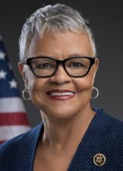
Congresswoman Bonnie Watson Coleman
“The Call to Act &
the Courage to Lead”
What it takes to WIN

Slide 35

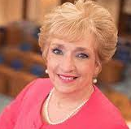
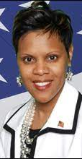
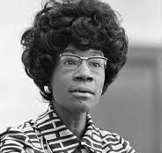
Marie Blistan
Immediate Past President, New Jersey Education Association
Assemblywoman
Shavonda E. Sumter
Chair, New Jersey Legislative Black Caucus

Slide 36
PART III - What Can Be Done?
A Legislative Agenda
for Dismantling Segregation
in Our Schools
in Our Time
Presented by:
Rev. Kenneth Darryl Ray Clayton
Rev. Karen Hernandez-Granzen
Rev. Willie Dwayne Francois

Slide 37
Segregation is Sin
It thwarts opportunity, harms our economy, divides our politics, & cuts short lives.
Integration is simply the absence of segregation – absence of a structure of “external containment”.
It is rooted in discrimination, subjugation, oppression & exploitation.
It is not a choice made by the segregated. It is a set of immoral laws & polices upheld by the powerful that limit choice, opportunity & life outcomes for the powerless.
But immoral laws & policies can be changed by moral courage, a determined people & organized power.

Slide 38
Framework for a
Legislative Approach
Ending School Segregation in New Jersey in Our Time

Slide 39
1. Must Involve Everyone
All districts bear some responsibility.
All have a role to play.
  Shut off all doors to “flight”
  Small scale pilot projects do not work.
  Must engage whole regions
  Must be implemented statewide.

Slide 40
2. Set Achievable, Fair Goals for Inclusion & Integration
State’s Aim should be
to support, incentivize & require all districts, school buildings, & classrooms
to better reflect the diversity of their regions & the state.

Slide 41
Maps Show Where School Districts Compare to the State Demographics
Examples:
  Trenton Region
  Atlantic City Region
  Camden Region
  Newark Region
Notice districts that mirror the state’s diversity.
Effective Plan = Help districts look more like these places AND help those places do a better job with integration & inclusion.
    Notice Hamilton & Lawrence Twp.

Slide 50
3. Base Goals on Opportunity as well as race
Opportunity is defined by social & economic factors:
  Number of low-income students
  Test scores
  Per Pupil Tax Capacity
Next map: Opportunity factors by school district
Green & Blue are Highest Opportunity districts
  Few low-income students
  Best test scores
  Highest Ratable Tax Base
  Should have the greatest obligation to meet regional inclusion & integration goals.

Slide 51
Notes:
This is an example of a metropolitan opportunity index (by school district). It measures opportunity using factors including % of Free & Reduced School Lunch, % of students proficient in Math & Reading, Per Pupil-Property Tax Capacity. Green & Blue areas are the highest opportunity communities with very few low-income students, best scores & highest ratable base. Highest opportunity school districts would have the greatest obligation to meet regional diversity & integration goals.

Slide 53
4. Combined Approach.
Using Diversity and Opportunity Analysis, the state can employ multiple policy tools for meeting inclusion goals for every district, school, classroom.
Most already exist in NJ law. But need reform:
  Strengthen school funding formula
  Reform intra-district choice program
  Pro-integration magnet & county school program
  District & classroom level strategies and best practices
  Use Fair Housing goals & obligations
  Reform School Consolidation bill
  Strengthen the Civil Rights capacity of the DOE

Slide 54
The School Funding Reform Act of 2008
This system (when fully funded) does much to incentivize diversity & inclusion.
But it can do more.
State aid should prioritize & advantage diverse districts.
Funding should support strategies that foster inclusion within districts, schools & classrooms.
High poverty districts should not be penalized.
Funding should only support high opportunity districts as they diversify.

Slide 55
Inter-District Public School Choice
This program, in its current form, does NOT promote integration.
But it can if it is reformed.
  Make it mandatory for high opportunity districts that fall short of regional integration goals.
  Spaces in these districts can be prioritized for students from the most segregated, high poverty districts.

Slide 56
County School System & Magnet Schools
County technical, trade & vocational schools often already serve as regional, more integrated, alternatives.
Should require regional goals for economic & racial balance.
Enact legislation to create & support pro-integration regional magnet schools in urban areas.
Legislation must require charters to also meet regional integration goals.

Slide 57
Reform School Consolidation bill
The new school consolidation bill must be amended to:
  prohibit withdrawal, separation or dissolution as a part of any proposed consolidation plan.
  Require an affirmative obligation to create a racially & socioeconomically integrated consolidated district.

Slide 58
Mount Laurel & New Jersey’s Fair Housing Act
Include Affordable Housing in goals for school & classroom integration.
Affluent districts who think they are too “far flung” to integrate can be required to deepen their affordable housing obligation.

Slide 59
Bolster/Reform Department of Education’s
Civil Rights Capacity
All of these measures MUST have
strong state mandate & resources directed toward the achievement of integration goals.
Enact legislation to strengthen the Department of Education’s Civil Rights capacity & enforcement requirements – so DOE is charged with & capable of carrying out school desegregation goals.
DOE must have the capacity to conduct an Opportunity Analysis to develop inclusion goals for each district.

Slide 60
Caveats
Avoid Short-Term Quick-Fixes Especially ones that settle for costly expenditures instead of true inclusion.
Don't Blame the Victim - NJ’s high poverty & racially isolated districts did not create segregation. Their students did not choose it. They should not be asked to bear the burden of fixing it.
Not all Suburban & Urban Districts are the Same - Recognize that districts in New Jersey are more than just white or black; rich or poor; urban or suburban.
Do No Harm - The best intentions often bring unintended but harmful consequences.
  County consolidation will not capture a diverse enough area to impact segregation patterns.
  Simply removing district boundaries would accelerate white flight & deepen segregation.
  Magnet & vocational schools should not create a new layer of exclusivity & exclusion.
  Magnets, as well as charters, must meet meaningful goals for reflecting the economic & racial mix of their region.

Slide 61
  School Integration Will Not Fix All Problems
School Integration is not a substitute for ending residential segregation, economic inequality & racial discrimination
But it is a part of the problem & a part we can do something about.
But it is a part of the solution – and we can do something about it.

Slide 62
  This is a beginning framework.
  A starting point for developing a policy agenda in the next legislative session.
We call on our members, allies & policy makers to join us.
Turn these ideas into bold & transformative legislation that will promote and sustain racial & economic opportunity for all families, children & communities.

Slide 63
Opportunity Analysis.
  A desegregation plan must be based on a thorough analysis of racial as well as economic & social factors that define opportunity.
  Develop integration & inclusion goals based on opportunity & diversity.
Legislation is needed
  To reform & strengthen the Department of Education’s civil rights capacity & enforcement requirements so that it is both charged with & able to carry out school desegregation goals.
  Strengthen state funding formula to advantage & incentivize diverse & integrated schools.
  Direct and increase funding to local integration & desegregation best practices where diversity already exists.
  Reform Interdistrict Public School Choice program to advance integration within regions based on opportunity analysis.
  Reform legislation to require charters to advance integration - not promote segregation.
  Support pro-integration magnet schools in urban areas and for county schools.
  Increase & enforce Mount Laurel obligations on “far flung” high opportunity communities with exclusionary schools.
Summary

Slide 64
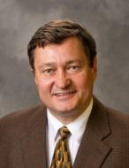
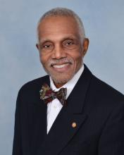
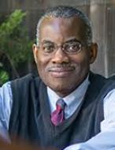
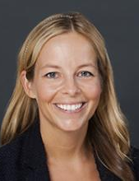
Response & Reaction
Can this work?
What advice do you have?
Will you help?
Professor Leslie Wilson,
Montclair State University (Moderator)
Professor John Brittain,
Professor of Law, UDC David A. Clarke School of Law
Dr. Genevieve Siegel-Hawley, Virginia Commonwealth University
Paul Jargowsky,
Director, Center for Urban Research &
Urban Education, Rutgers University

Slide 65
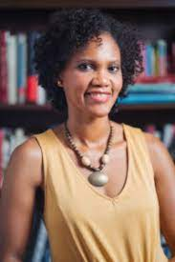
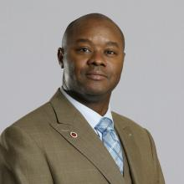
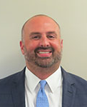
Response & Reaction
What about this resonates with you & your experience?
Patrick F. Carrigg, Esq
School Board Attorney
Charles E. Menifield, PhD
Dean, School of Public Affairs & Administration, Rutgers University
Monique Coleman,
Highland Park BOE member

Slide 66
Response & Reaction
Policy Makers
  Senator Joe Cryan
  Assemblywoman Shavonda Sumter
  Assemblyman Benjie Wimberly
  Assemblywoman Mila Jasey

Slide 67
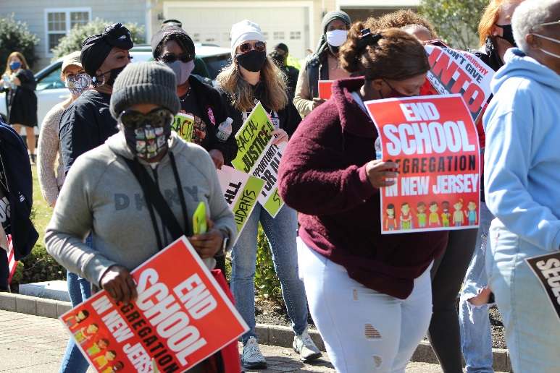
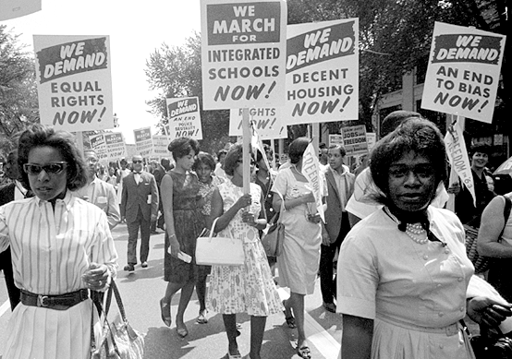
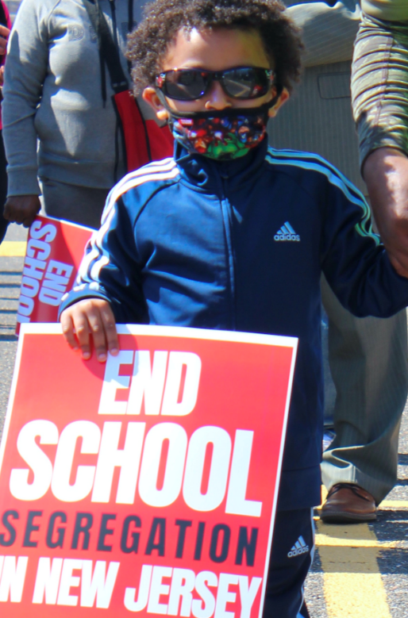
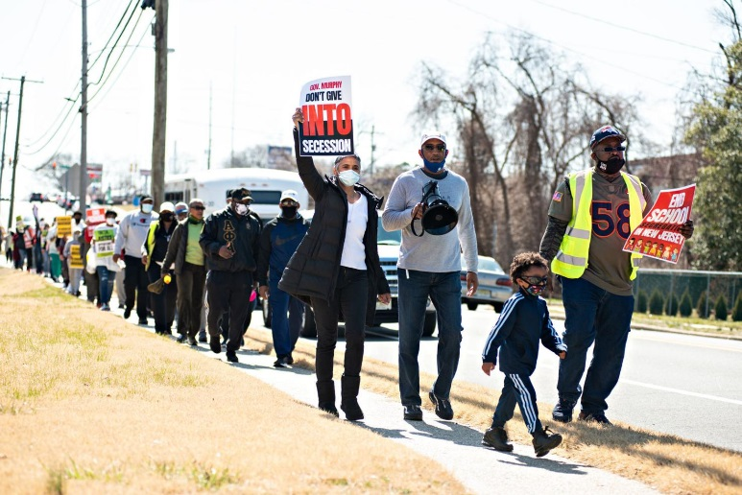
Call to Action
Next Steps
Feedback & commitments (from lunch)
Actions
  Regional Meetings with Legislators
  Engaging the Governor over the next 5 weeks
Weekly Zoom Check-In: Sundays (7pm)
  September 26
  October 3
  October 10
  October 17
  October 24
  October 31
  Until Nov 2nd Election

Slide 68
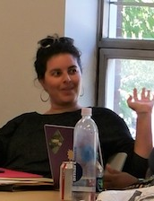
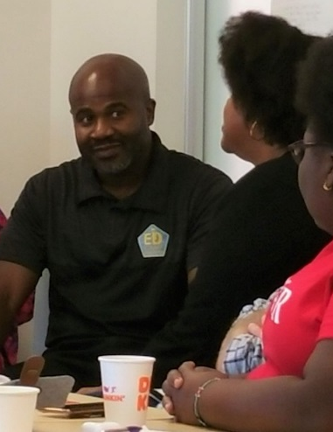
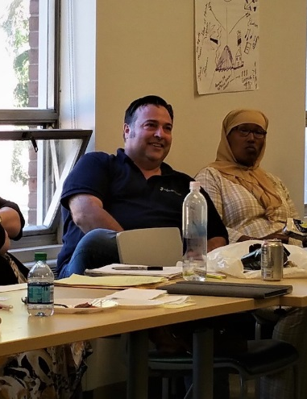
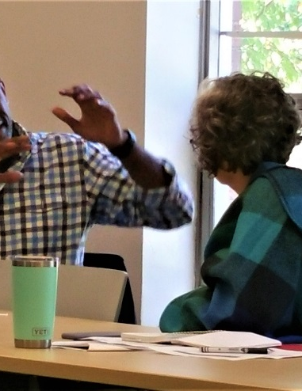
Leadership Training
4-Day National Leadership Training
Thursday through Sunday
December 2-5
    December 9-12
      December 16-19
Topics
  Learning about Power
  Understanding self-interest
  One-on-one organizing
  Power analysis
  Distinguishing “public” from “private”
  Strategy & tactics, issues & action
  Identifying & developing leaders
  Organizing money
  Effective meetings
  Strategic planning
Registration is now open

Slide 69
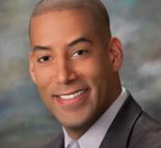
Closing Remarks
Sean Spiller
President, New Jersey Education Association (NJEA) & Mayor, Montclair

Slide 70
Closing Session
Conference Co-Chairs: Rev. Kenneth Darryl Ray Clayton
Rev. Willie Dwayne Francois III
Closing Statement
Closing Prayer

